Slide 1


Slide 2

A joint venture between two of the country’s leading property developers today, Ayala Land Inc.
and Eton Properties.

Slide 3
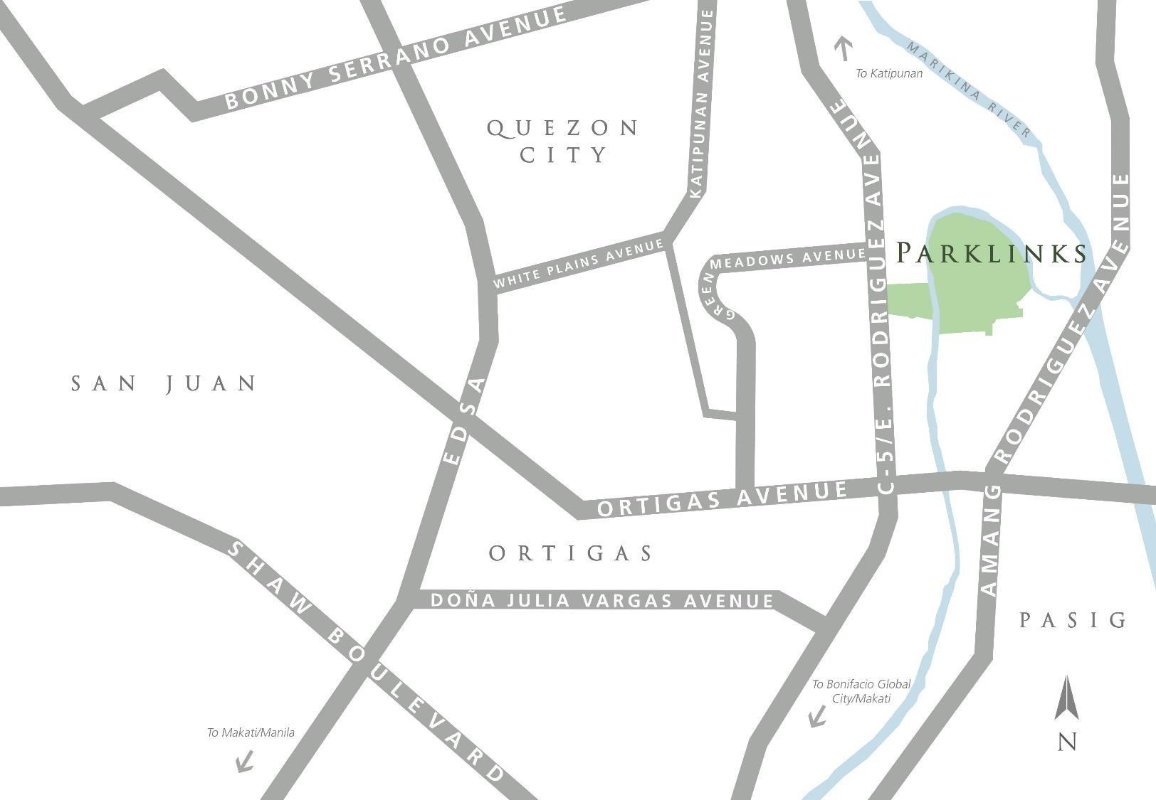


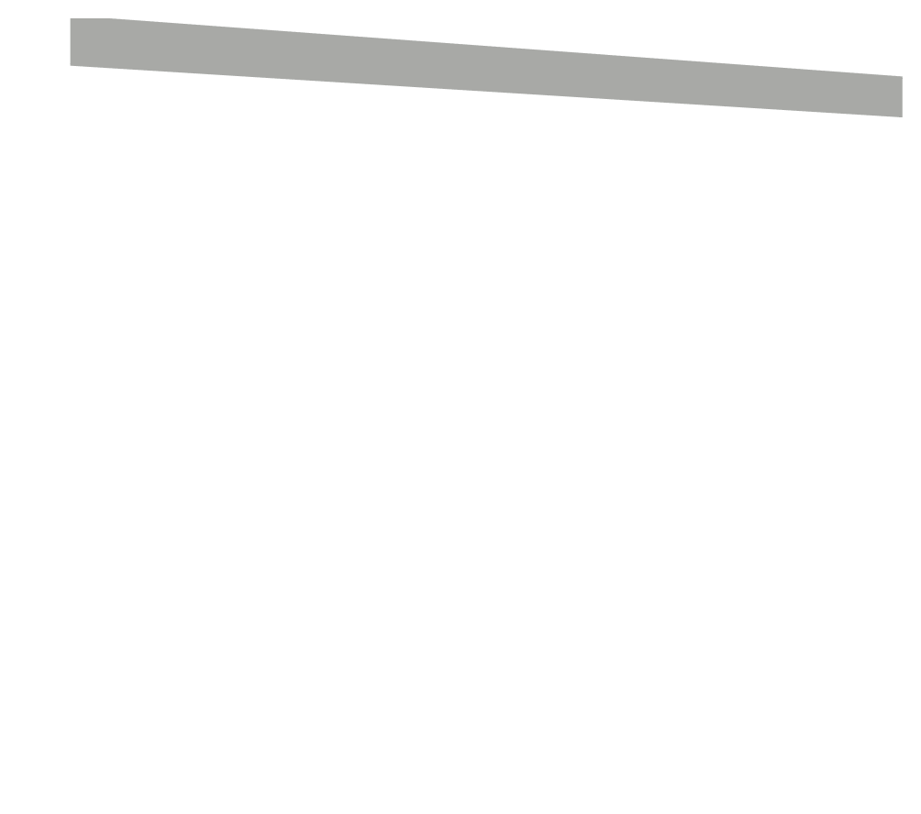




VICINITY MAP

Slide 4
Proximity
Key institutions andestablishments within reach

Slide 5



WHITE PLAINS
VICINITY MAP
CAMP CRAME
ST. PIO CHAPEL
legend
CAMP AGUINALDO
CHRIST THE KING PARISH
Key Institutions
THE MEDICAL CITY
WACK-WACK VILLAGE

Slide 6


VICINITY MAP
EASTWOOD CITY
legend
Key Institutions Commercial Areas
GREENHILLS SHOPPING
CENTER
WILCON DEPOT
ROBINSONS
WACK-WACK VILLAGE
GALLERIA
ORTIGAS EAST
SM MEGAMALL
EDSA SHANGRI-LA
AYALA MALLS THE 30TH
ESTANCIA
CAPITOL
COMMONS

Slide 7


TO ATENEO, UP DILIMAN, MIRIAM
VICINITY MAP
legend
XAVIER SCHOOL
Key Institutions Commercial Areas Major Schools & Universities
IMMACULATE
CONCEPTION
LA SALLE GREENHILLS
ACADEMY
ST. PEDRO POVEDA COLLEGE
WACK-WACK VILLAGE
UNIVERSITY OF ASIA &
ST. PAUL COLLEGE
THE PACIFIC
LOURDES
SCHOOL
TO BGC
SCHOOLS

Slide 8


SAINT
IGNATIUS
WHITE PLAINS
VICINITY MAP
CIRCULO
legend
ACROPOLIS
VERDE
Key Institutions Commercial Areas Major Schools & Universities
Residential Villages & Buildings
GREENMEADOWS
CORINTHIAN
HILLS
CIRRUS
VELARIS
WACK-WACK
CORINTHIAN
VALLE VERDE
VILLAGE
GARDENS
WACK-WACK
GOLF AND
COUNTRY CLUB
ONE SHANG
WACK-WACK
VILLAGE
SHANG
VALLE VERDE
THE GROVE
WACK-WACK
VALLE VERDE

Slide 9
The Estate
a premier address within a master-planned, mixed-use,
and sustainable estate

Slide 10
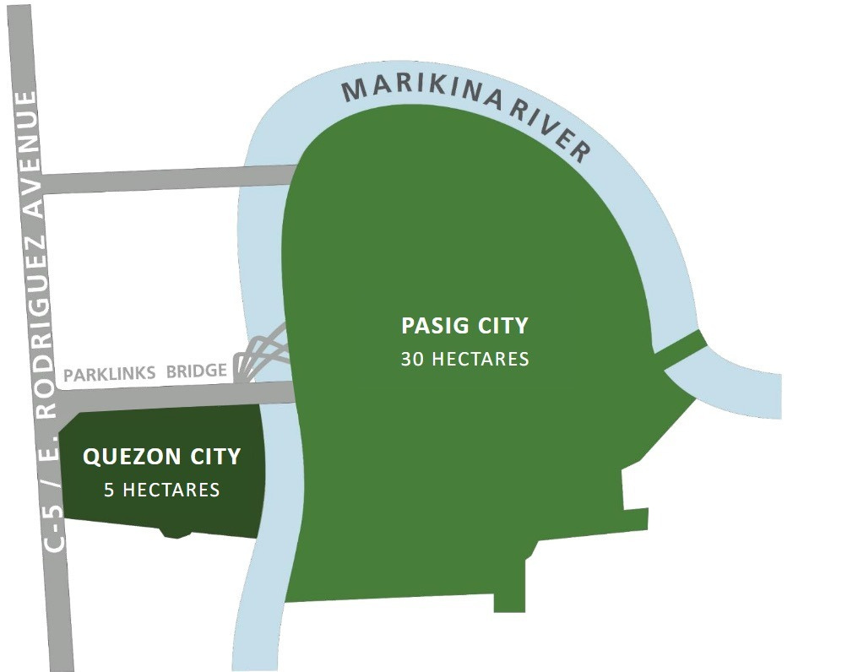
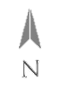
Parklinks Estate
Site Development Plan
Quezon City
5 hectares 30 hectares
Pasig City

Slide 11
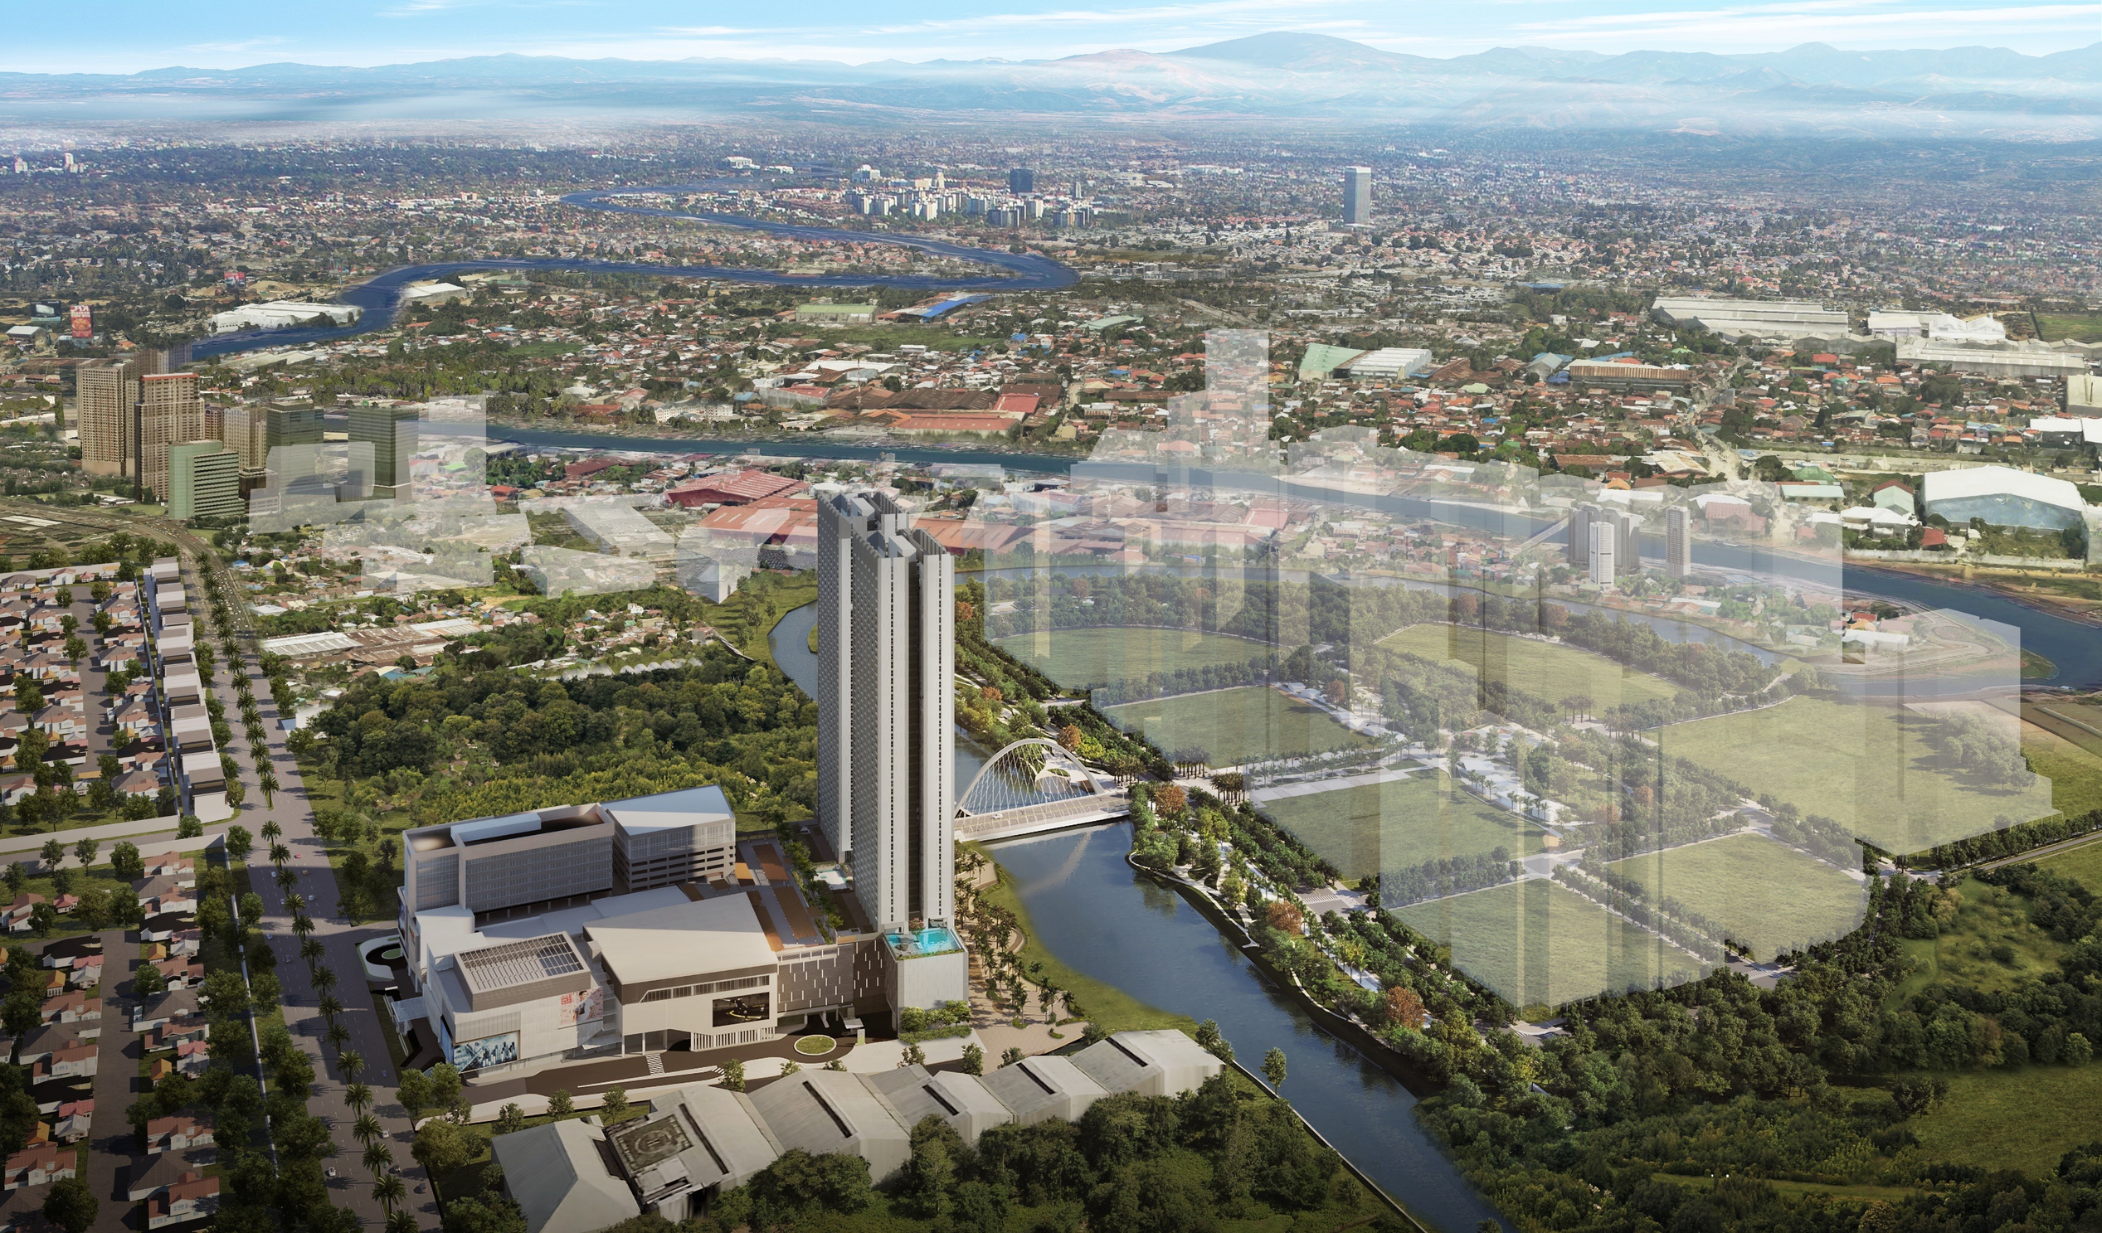

Pasig City Parcel 30 hectares
Quezon City Parcel 5 hectares
C-5 | E. Rodriguez Avenue

Slide 12
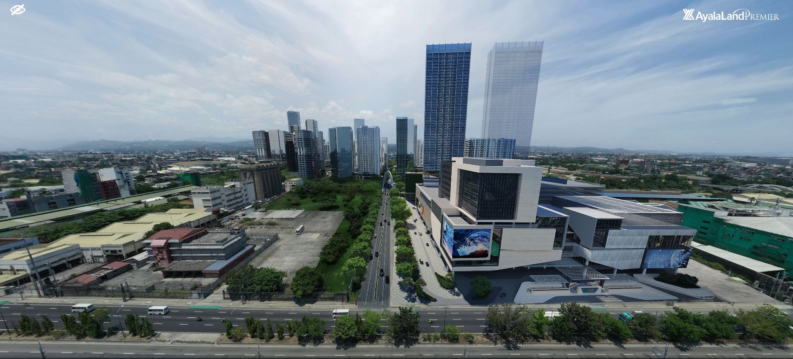
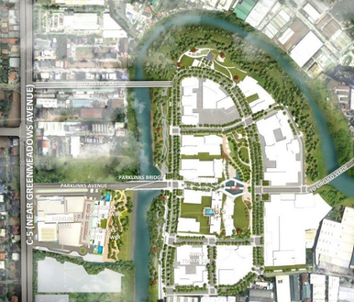

Estate Access Parklinks Avenue
•
4 lane main access road which is connected to the iconic Parklinks Bridge and eventually leads you to the Pasig parcel.
Parklinks Avenue

Slide 13
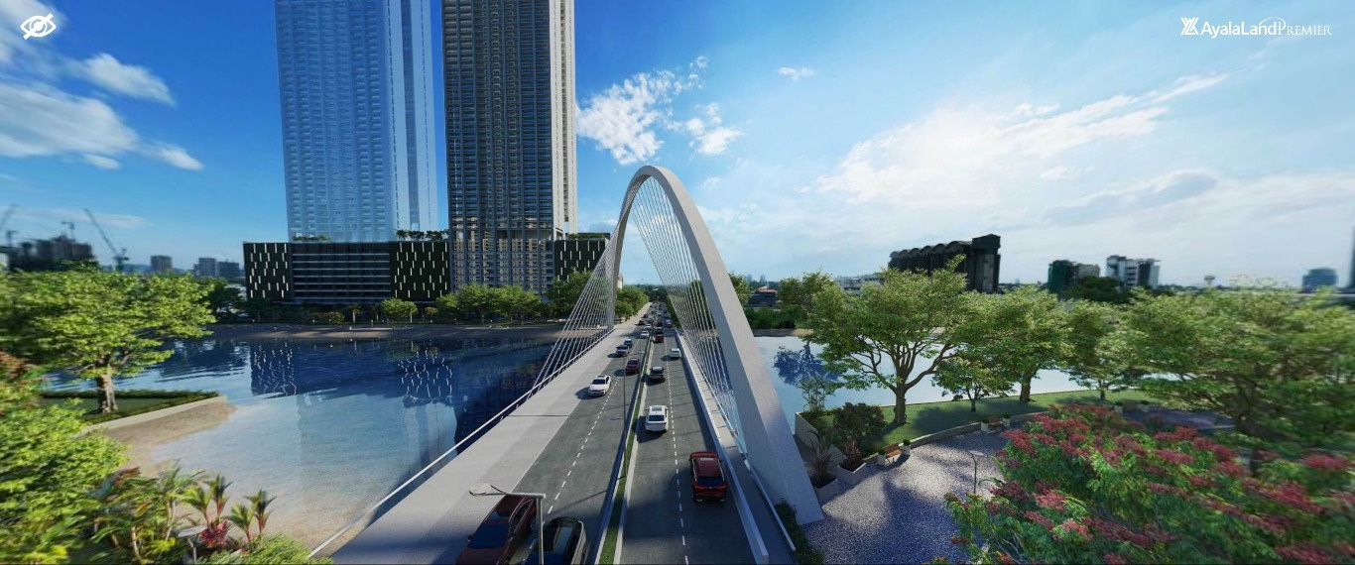

Iconic Parklinks bridge
Estate Access Iconic Parklinks Bridge
•110-meter iconic bridge which connects the Quezon City and Pasig City parcels. The bridge also features a 3-meter bike lane.

Slide 14
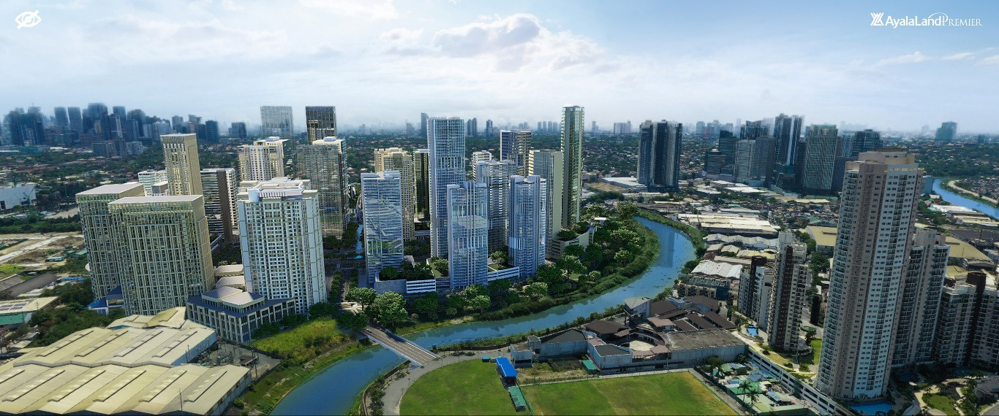

Estate Access Circulo Verde Access
•
Access road linking Parklinks and Circulo Verde which allows greater connectivity amongst estates along the C-5 corridor.
Circulo Verde Access

Slide 15
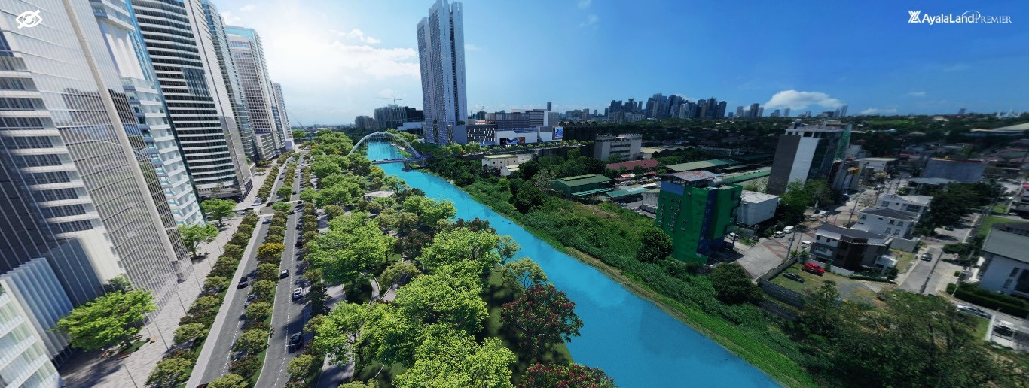

Estate Access Metropoli Access
Future connection between Metropoli and Parklinks (Pasig parcel) Help decongest traffic along Parklinks Avenue
Metropoli access
•
•

Slide 16
Estate Components

Slide 17
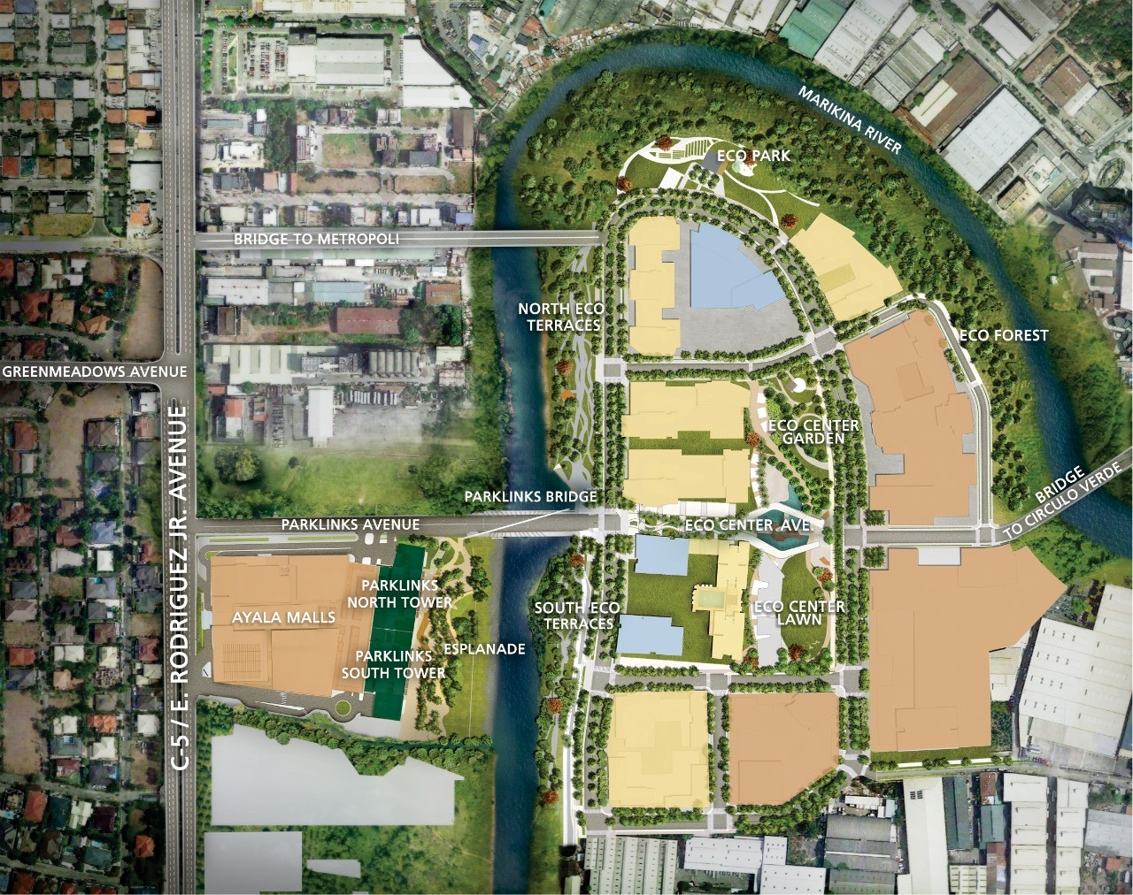

Slide 18
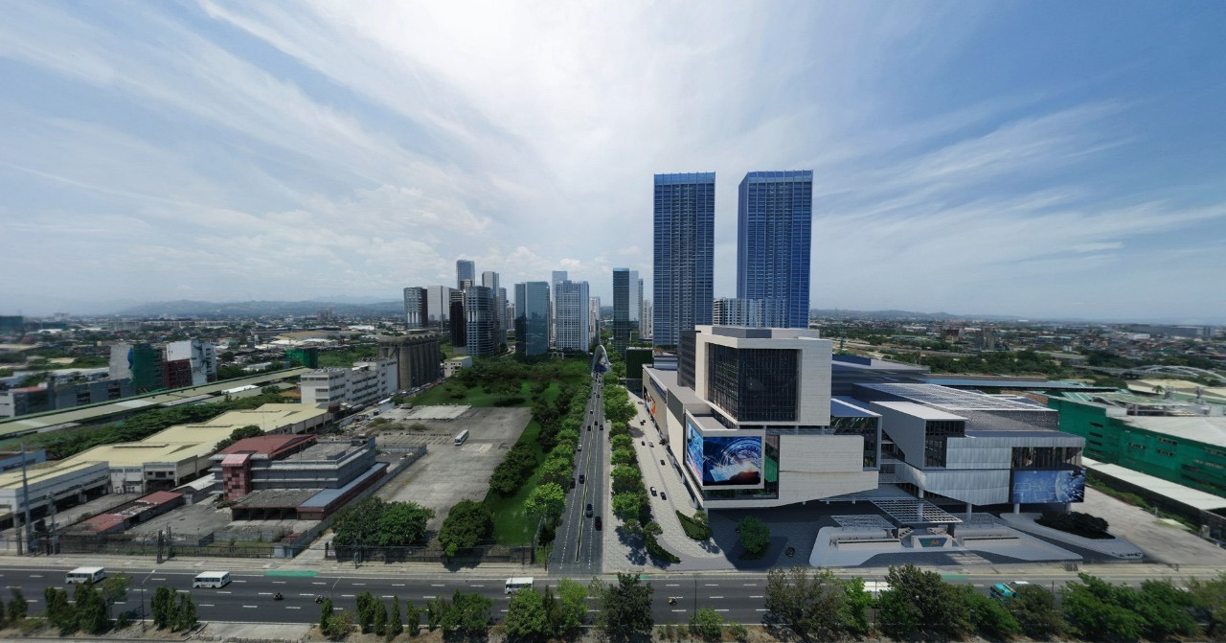
Estate Components Parklinks Mall
Parklinks Mall
•Mixed-use retail and office building with a direct connection to Parklinks North and South Towers.
•Total area of 135,000 sqm. •Target Resumption of Construction: 2023 •Target Construction Completion: 2026

Slide 19
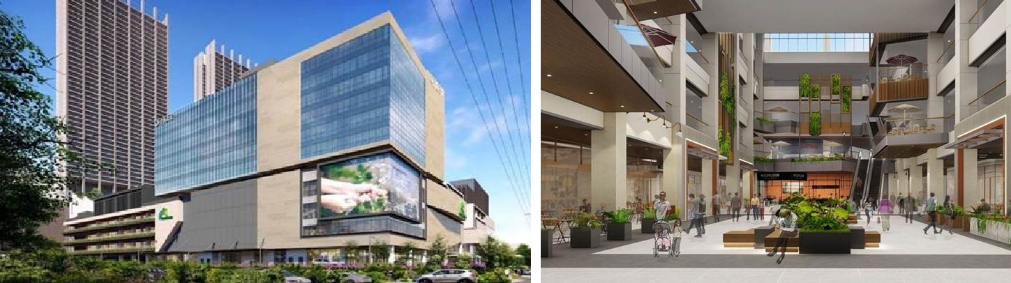
Disclaimer: Renders shown are unofficial and may still change

Slide 20
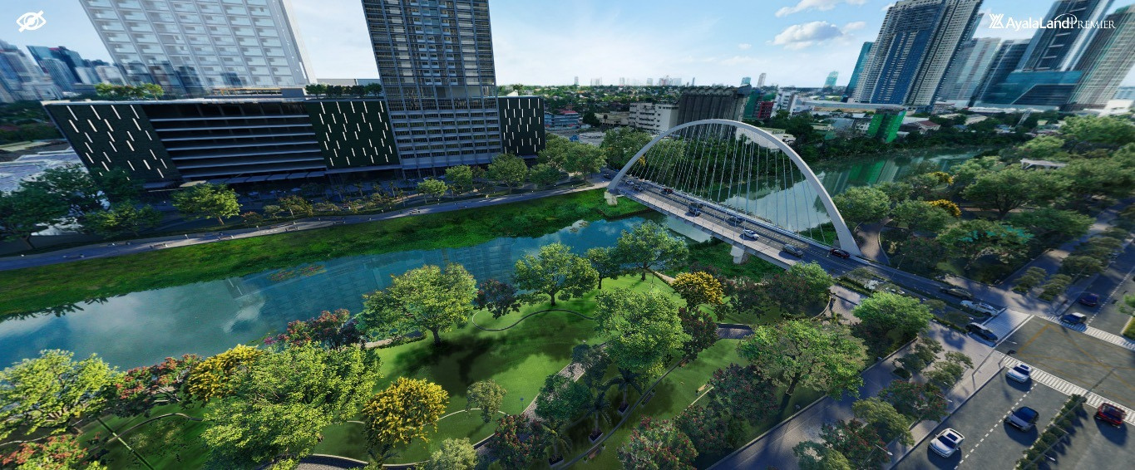

Estate Components Eco Terraces
•
•
•
Walk paths and bike lanes
Lush greenery
Views of the Parklinks bridge and Parklinks
North and South Towers
Eco Terraces (south)

Slide 21
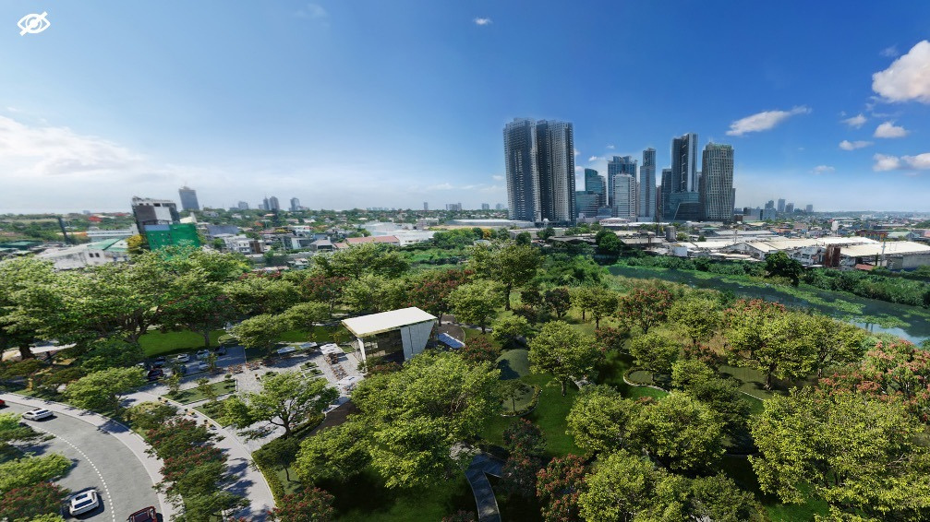
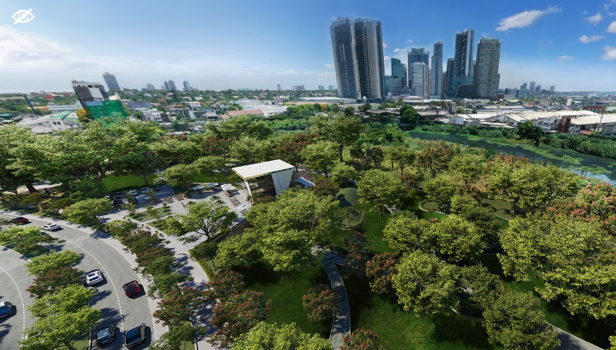

Estate Components Eco Park
Eco Park
•
•
•
Riverside Views
Lush greenery
Wetlands adjacent to the river

Slide 22
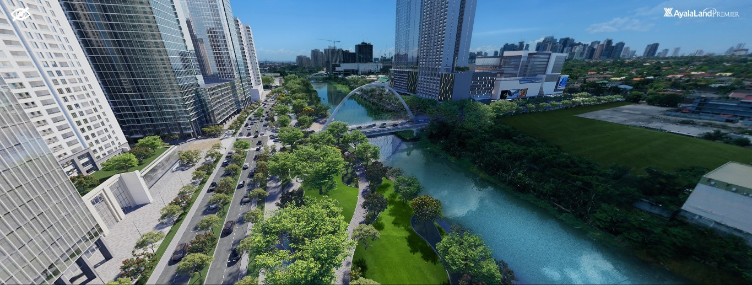

Eco terraces (north)

Slide 23
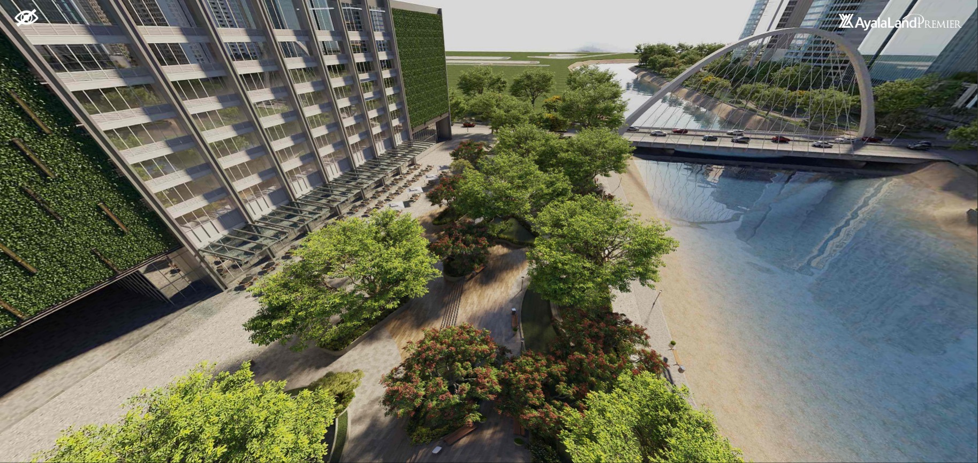
Esplanade
Estate Components Esplanade
•Restaurants and Cafés •Walk paths •Lush greenery

Slide 24
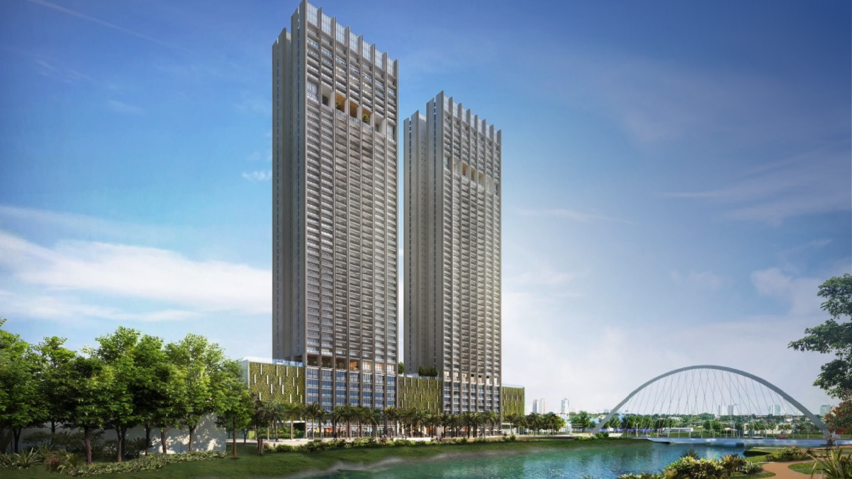

Development Summary
Land Area Total No. of Floors No. of Residential Units Unit Types Unit Size Range Floor Density
4,002 sqm 55 floors 313 units 1BR –3BR 70 –286 SQM. 4 –9 units per floor

Slide 25
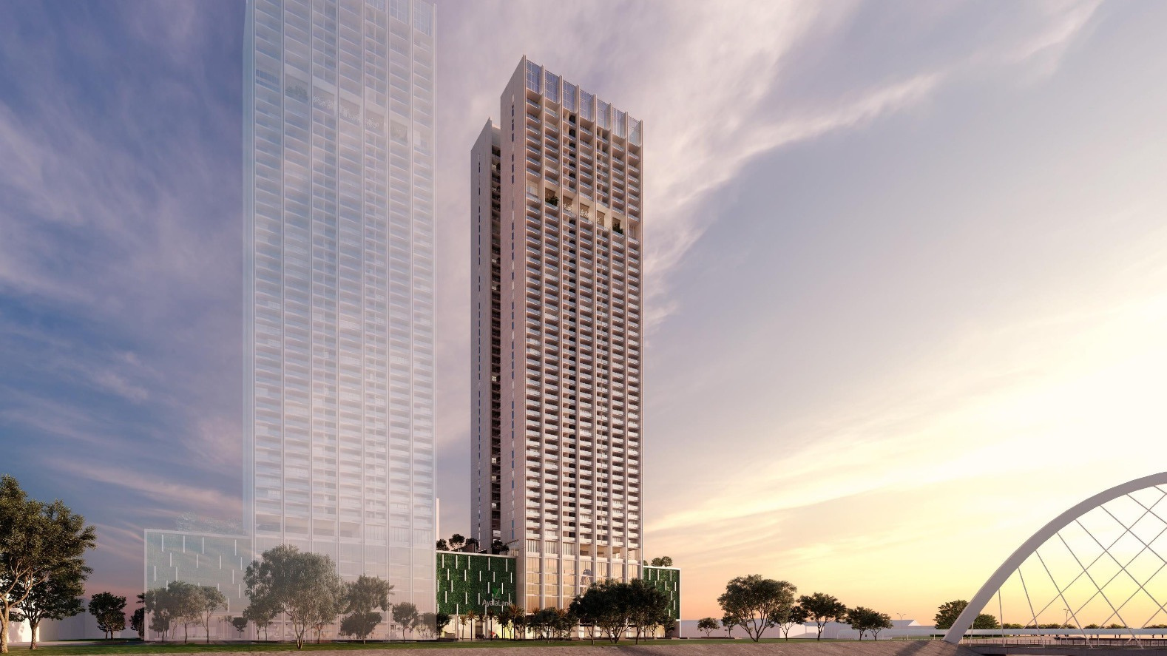

Development Summary
Land Area Total No. of Floors No. of Residential Units Unit Types Unit Size Range Floor Density
4,145 SQM. 55 floors 280 units 1BR –4BR 70 –306 SQM. 4 –8 units per floor

Slide 26


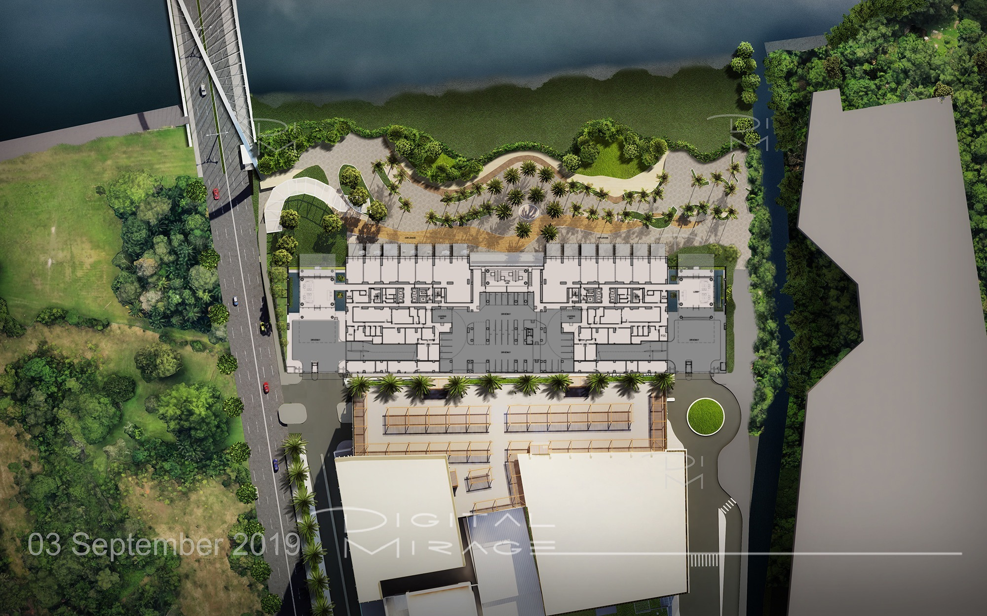





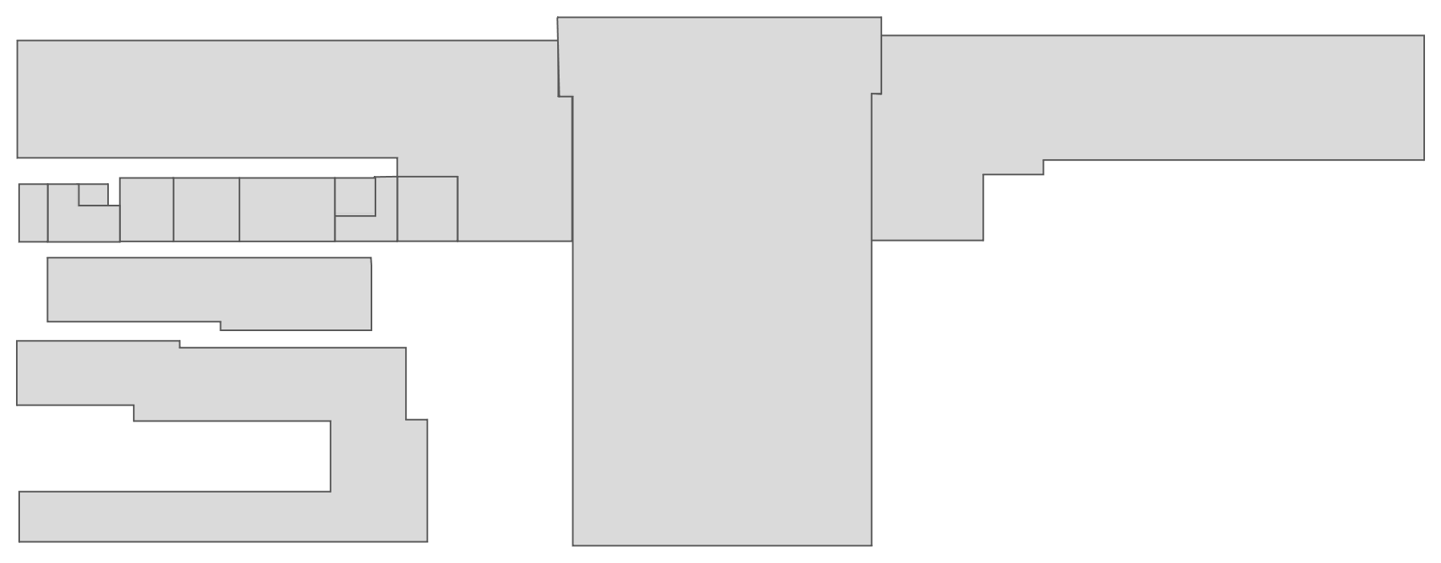
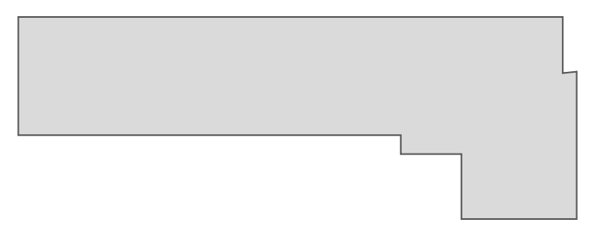
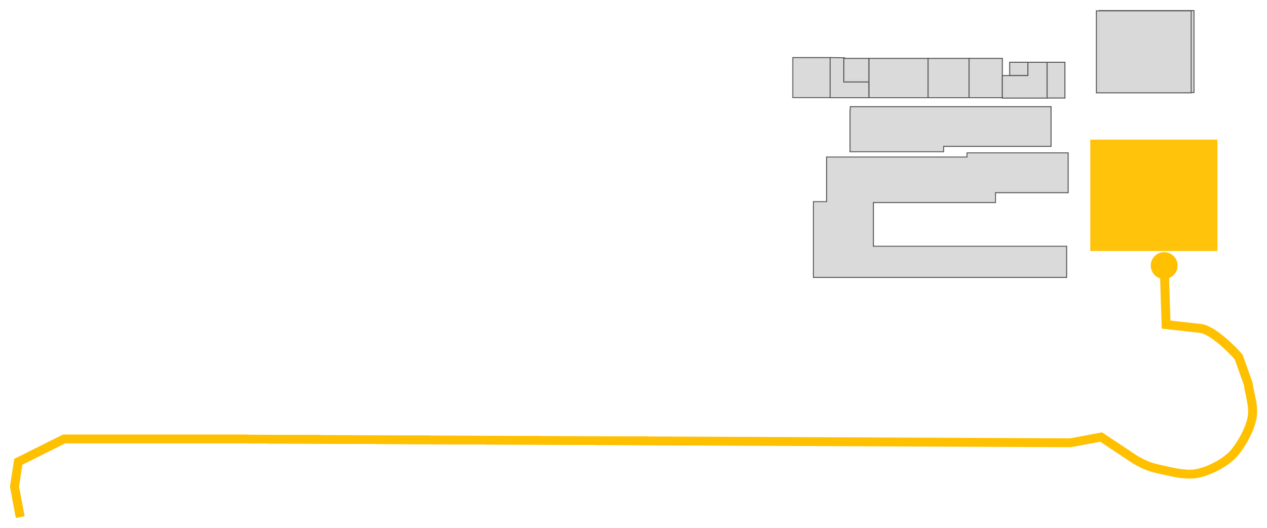






P.R.
RE SID E NT I
AL
LOADING
BAY
E
MOTORCOURT
MOTORCOURT
S
N
PARKLINKS MALL
W

Slide 27
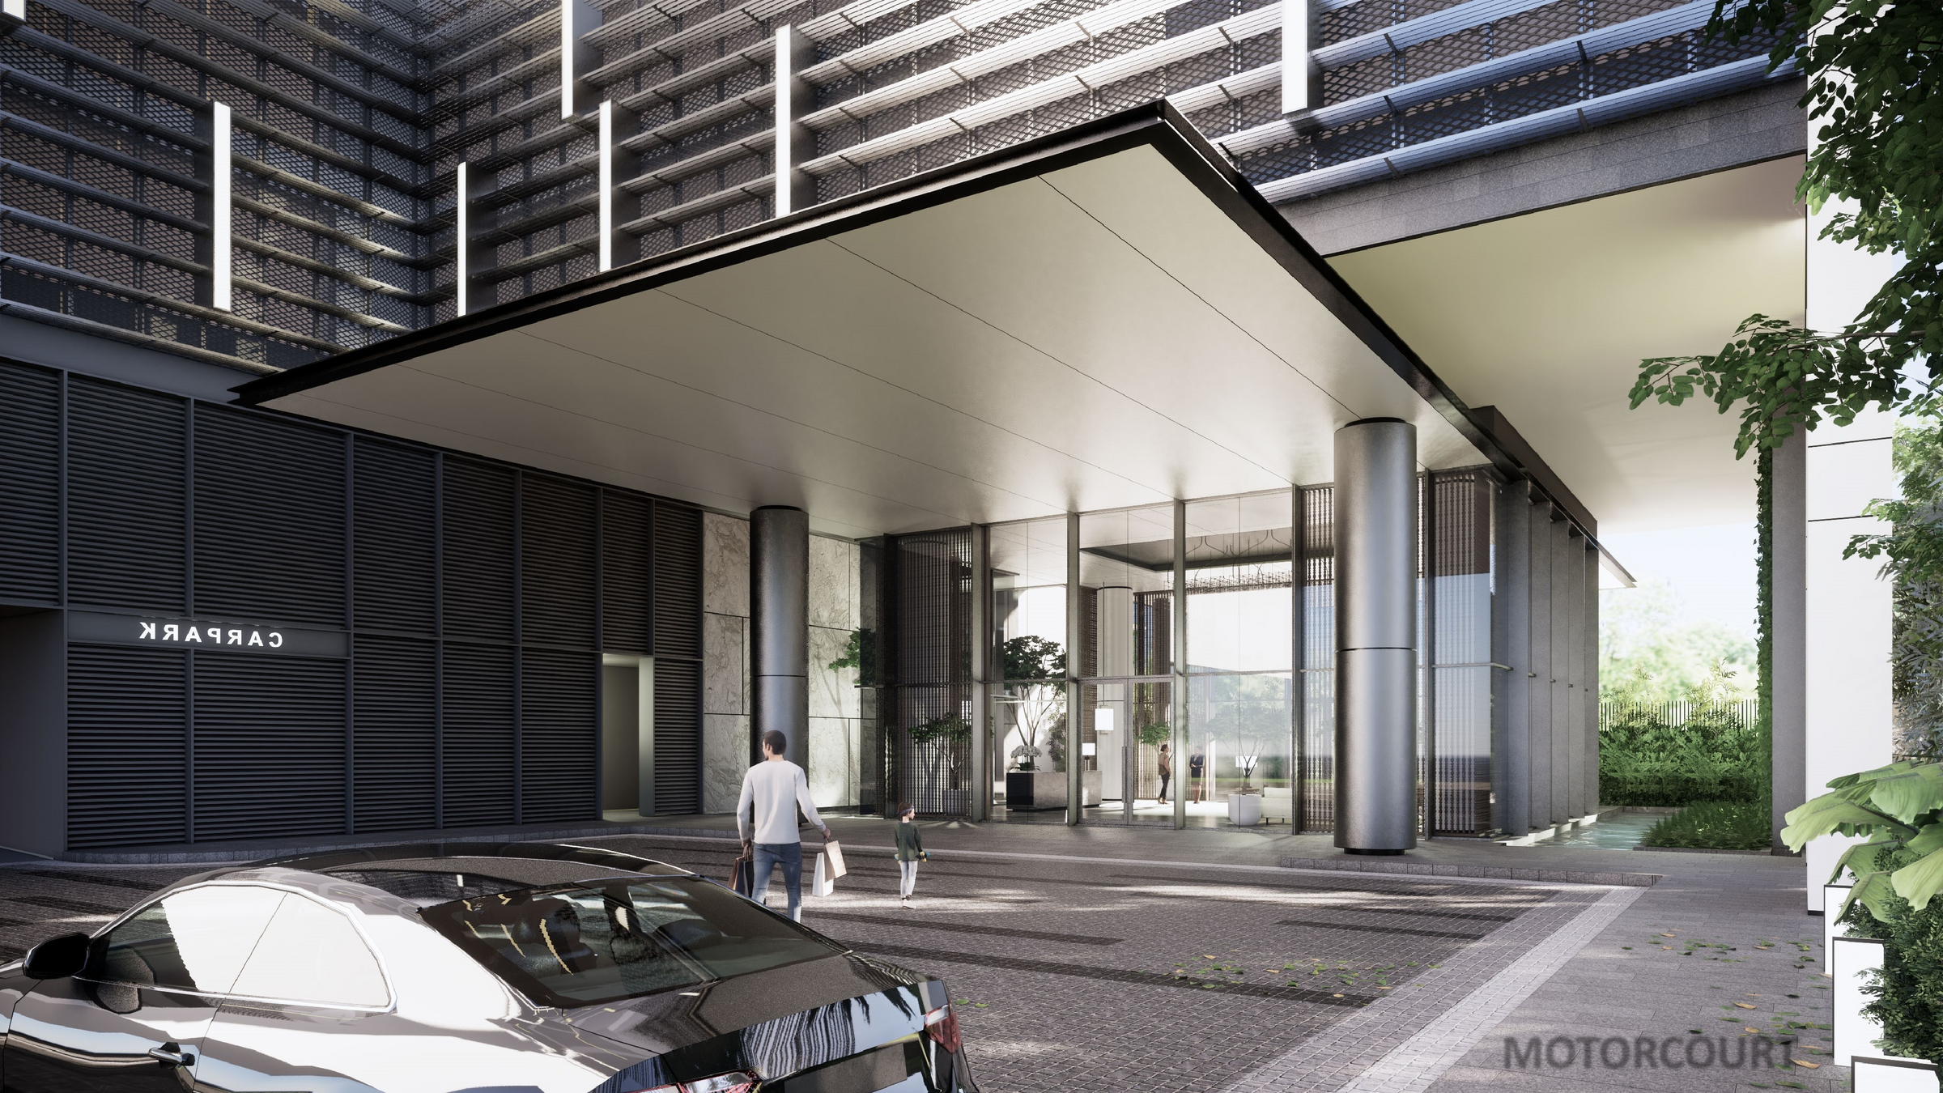

MOTORCOURT

Slide 28

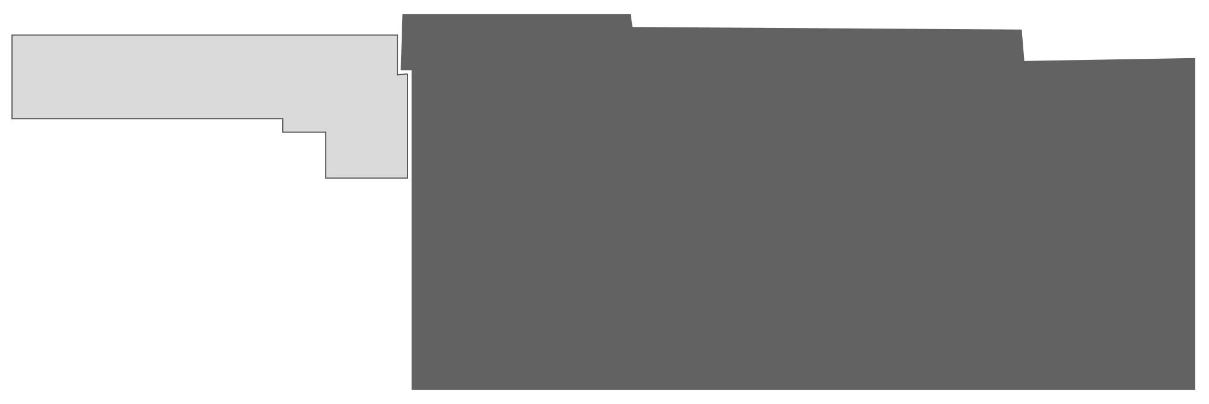
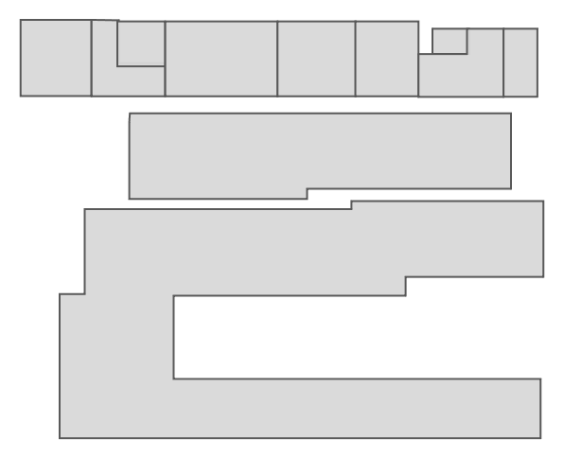








P.R.
RESIDENTIAL
RREESSIDIDEENNTTIAIALL L LOOB BB BY Y
RE SID E NT I
AL
LOADING
BAY
LOBBY
E
S
N
PARKLINKS MALL
W

Slide 29
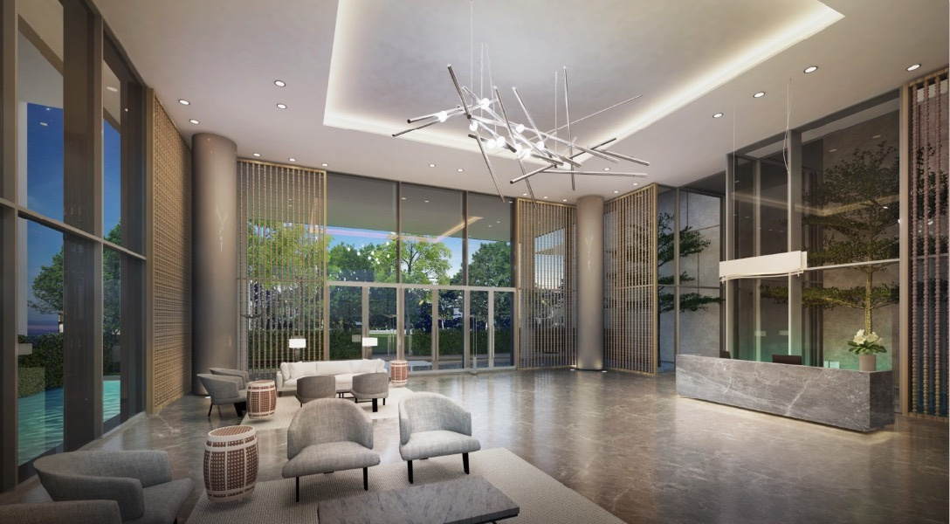


RESIDENTIAL LOBBY

Slide 30
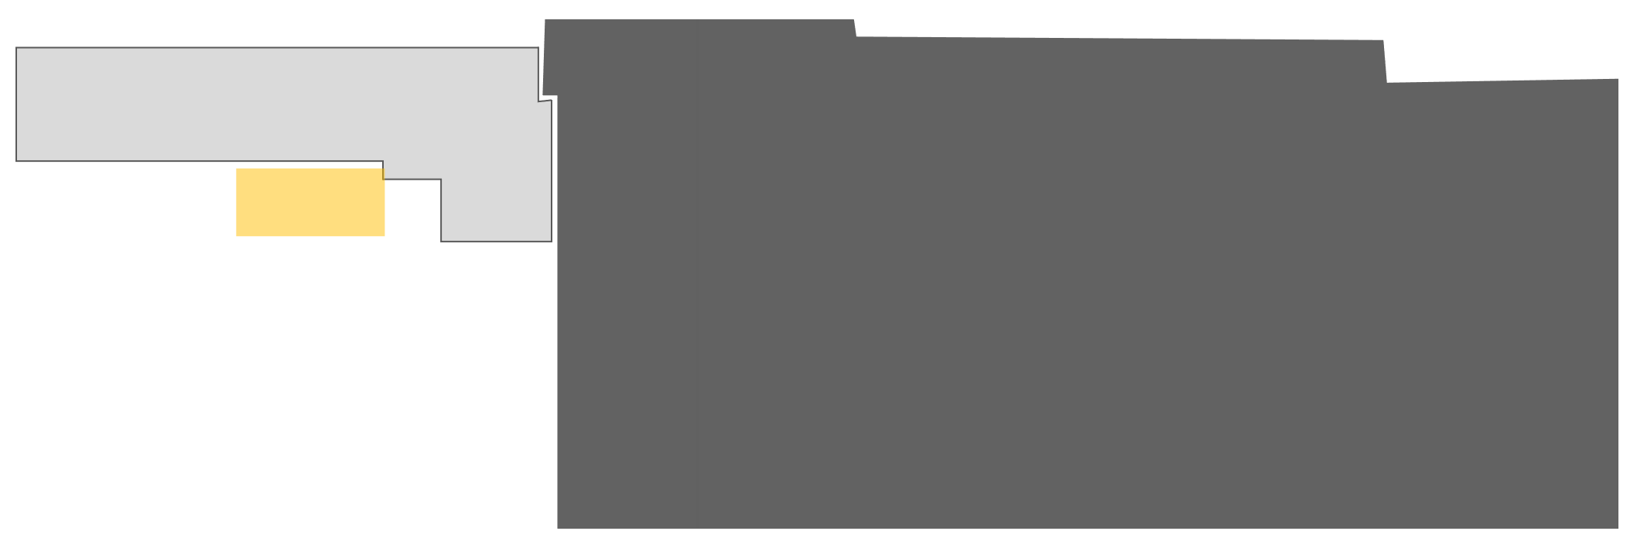
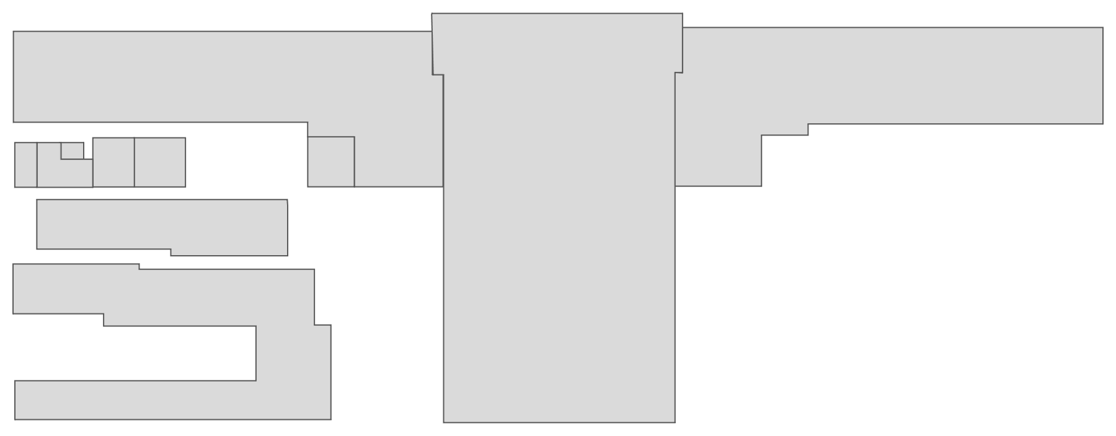
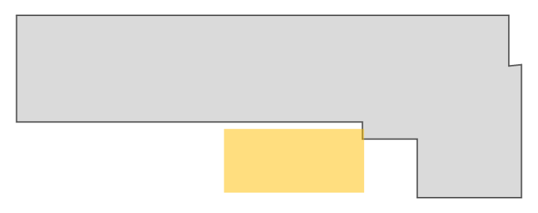



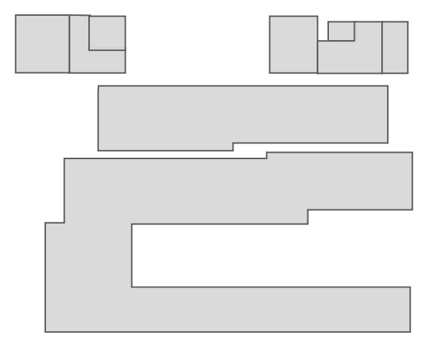
ELEVATOR LOBBY
ELEVATOR LOBBY
P.R.
RE SID E NT I
AL
LOADING
BAY
E
S
N
PARKLINKS MALL
W

Slide 31


4 HIGH SPEED LIFTS

Slide 32

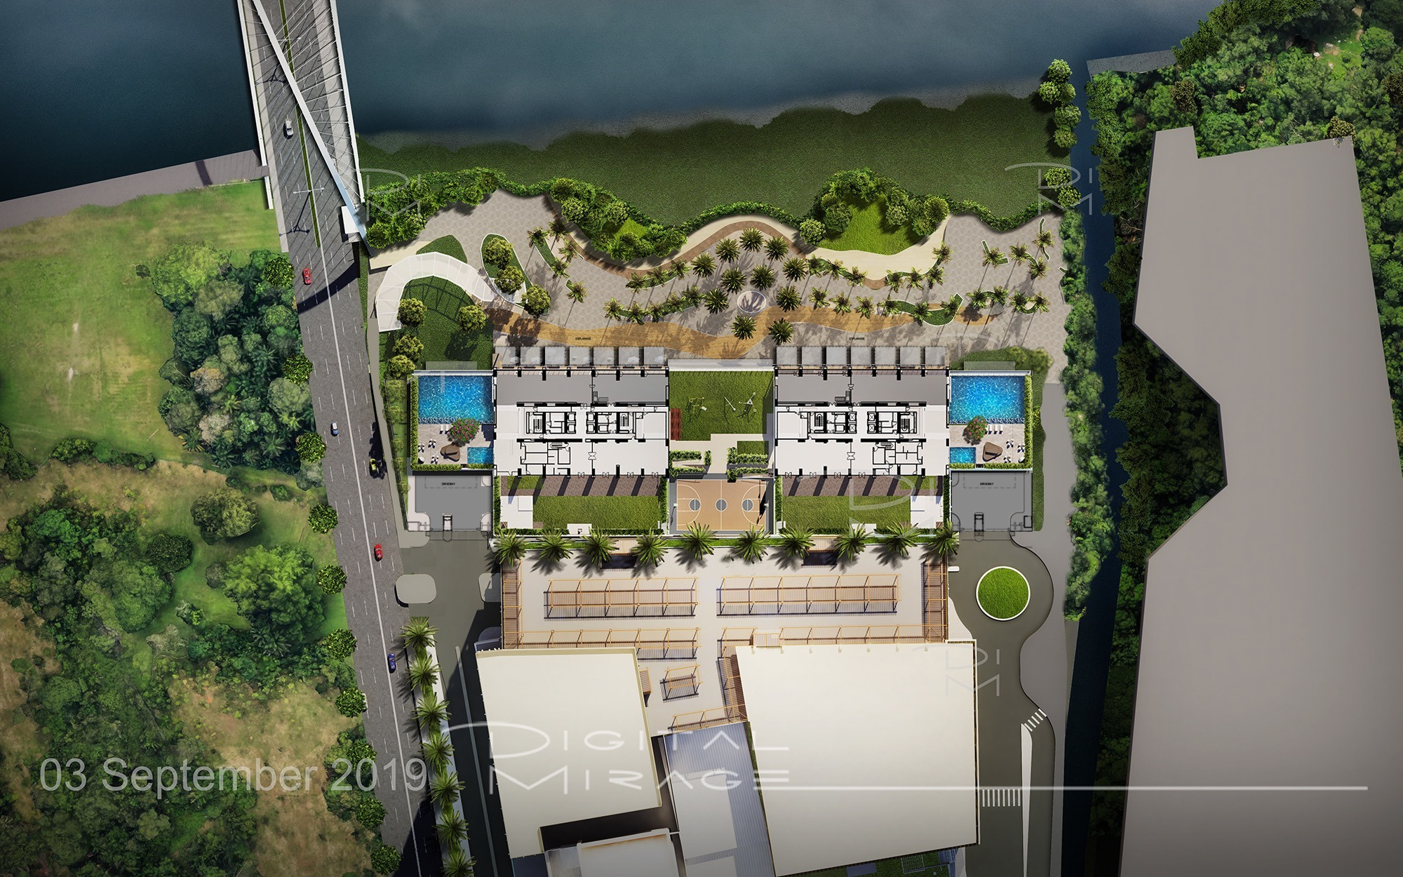
Amenity Deck
TENTH FLOOR (10F)
E
S
N
PARKLINKS MALL
W

Slide 33
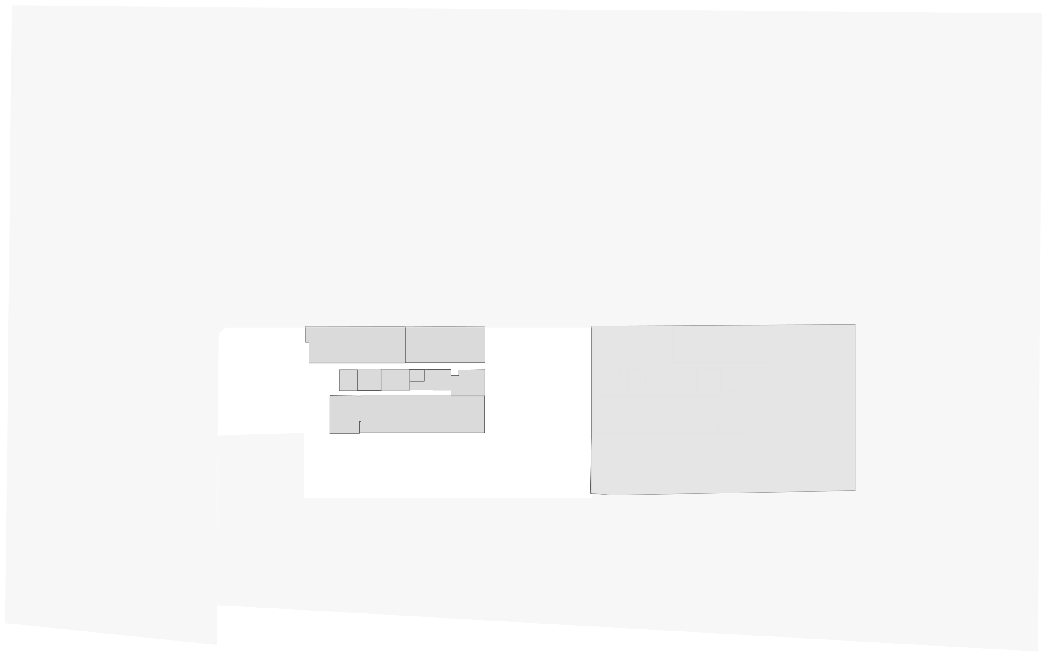
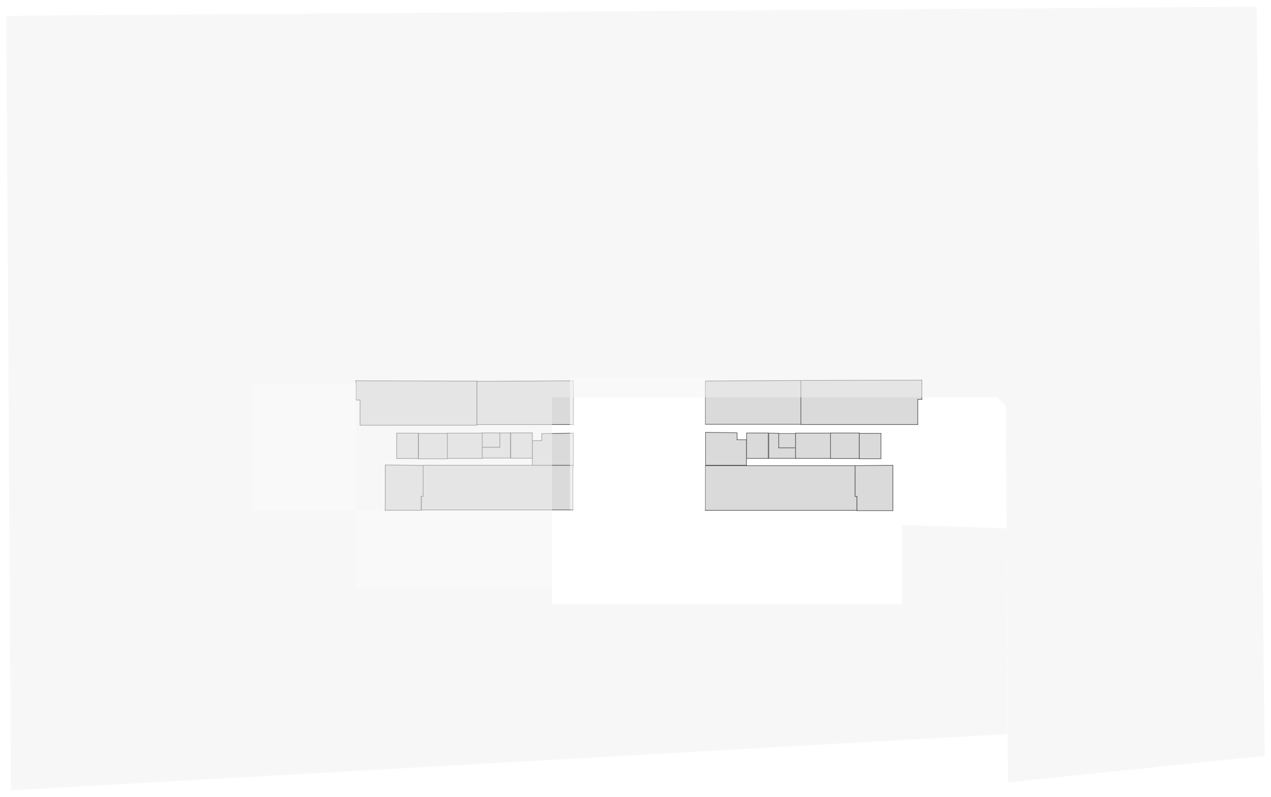

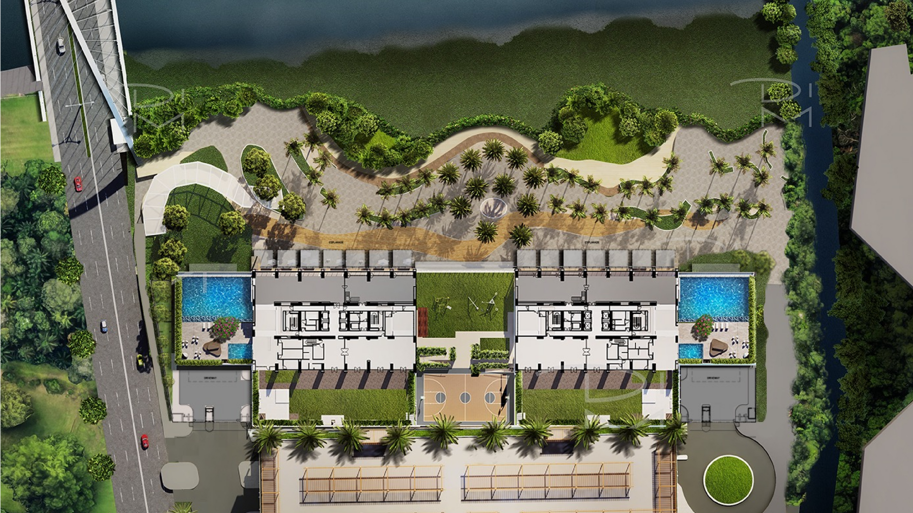

E
S
N
PARKLINKS MALL
W

Slide 34
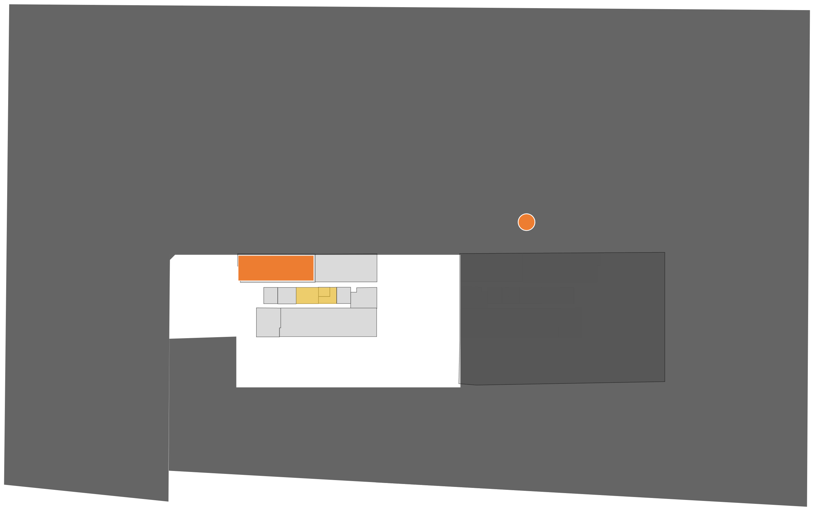
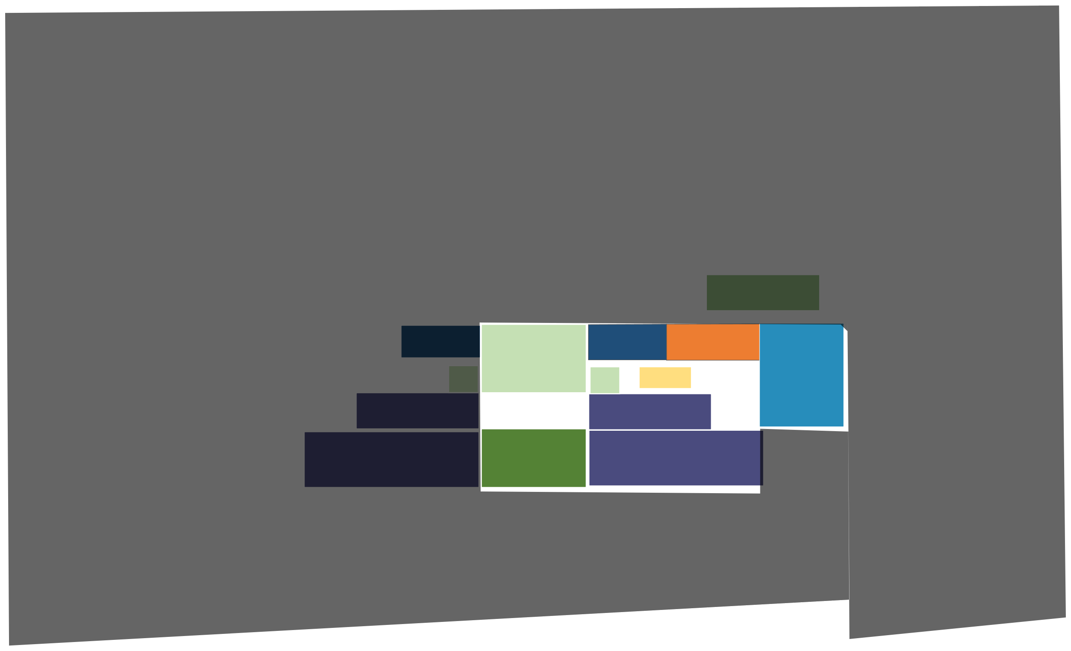










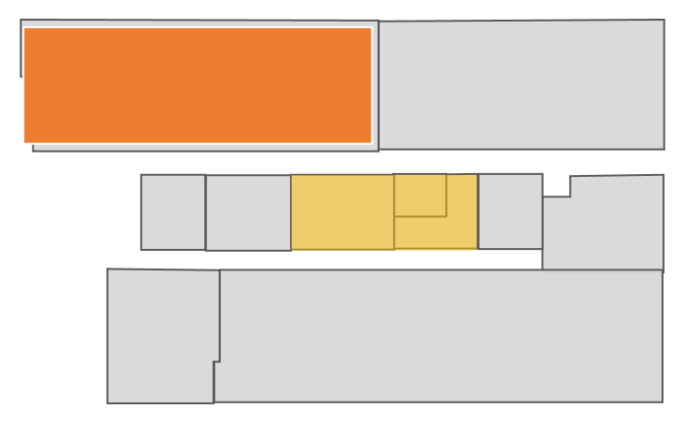
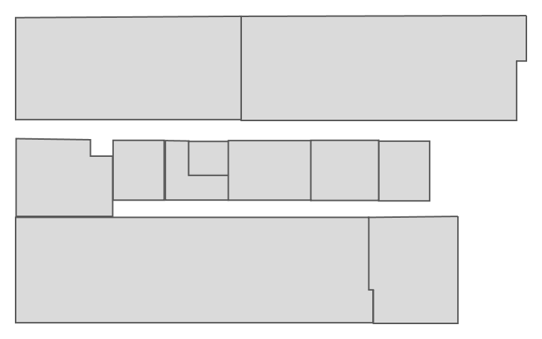







AMENIITY FLOOR
10//FF
OUTDOOR LOUNGE POOL COMPLEX FITNESS CENTER
OUTDOOR LOUNGE POOL COMPLEX FITNESS CENTER SOCIAL HALL & LAWN CHILDREN’S PLAY AREAS
E
SPORTS COURT
S
N
PARKLINKS MALL
W

Slide 35
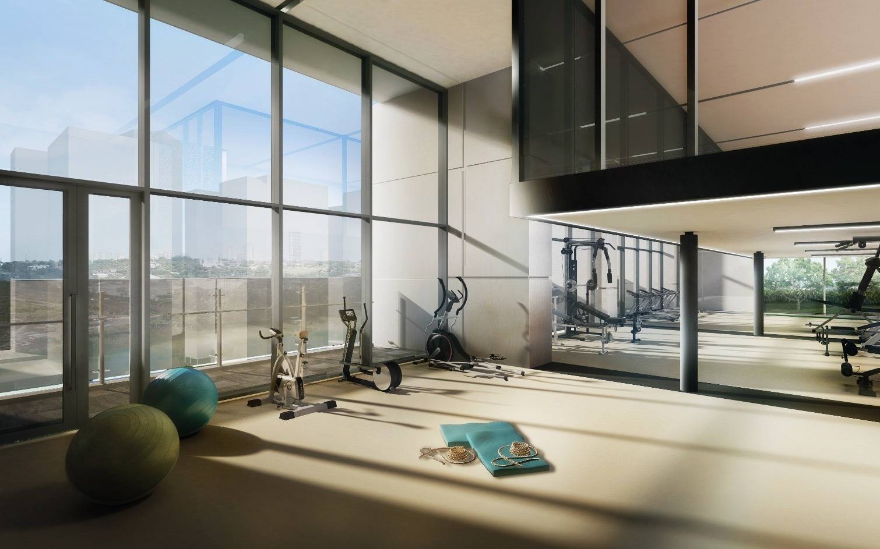
FITNESS CENTER

Slide 36
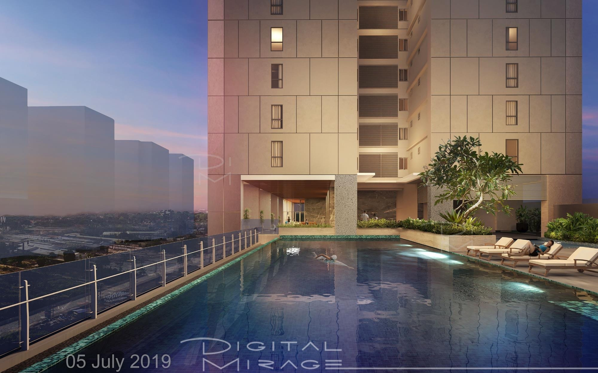
OUTDOOR LOUNGE & POOL COMPLEX

Slide 37
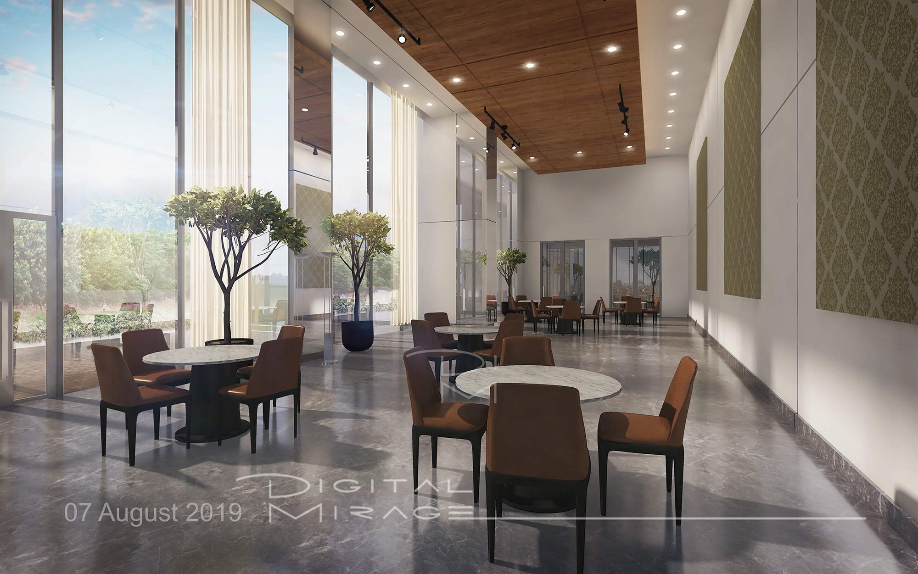
SOCIAL HALL

Slide 38
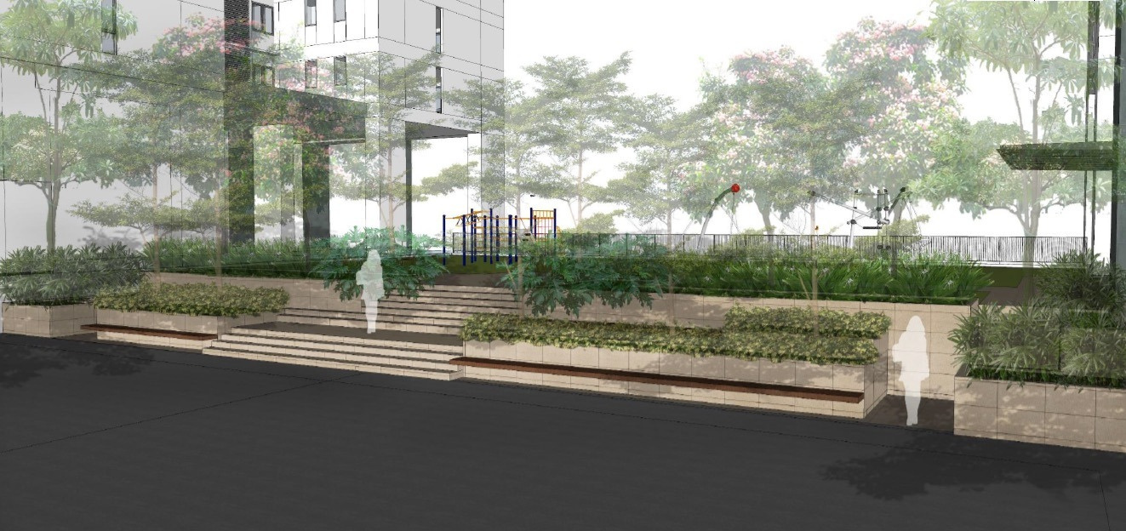
OUTDOOR PLAY AREA

Slide 39
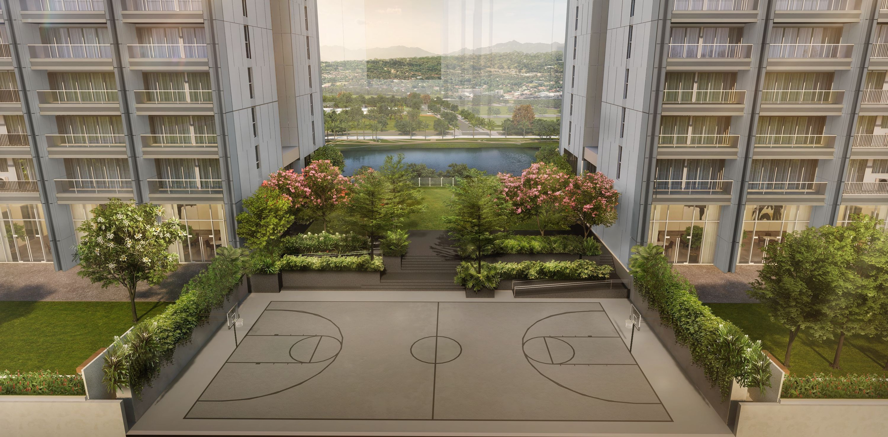
SPORTS COURT

Slide 40
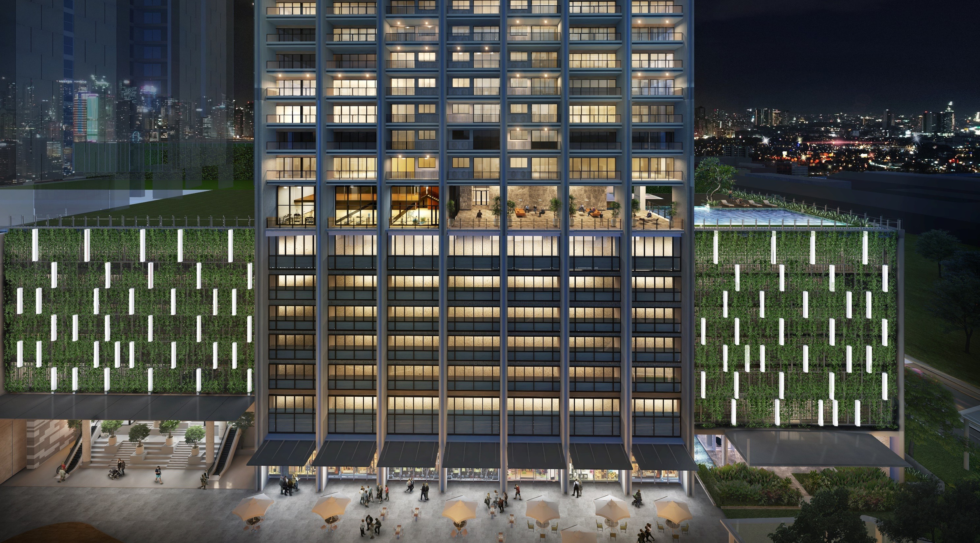

Slide 41
Horizon Terrace
FOURTY FIFTH FLOOR (45F)
E
S
N
PARKLINKS MALL
W

Slide 42
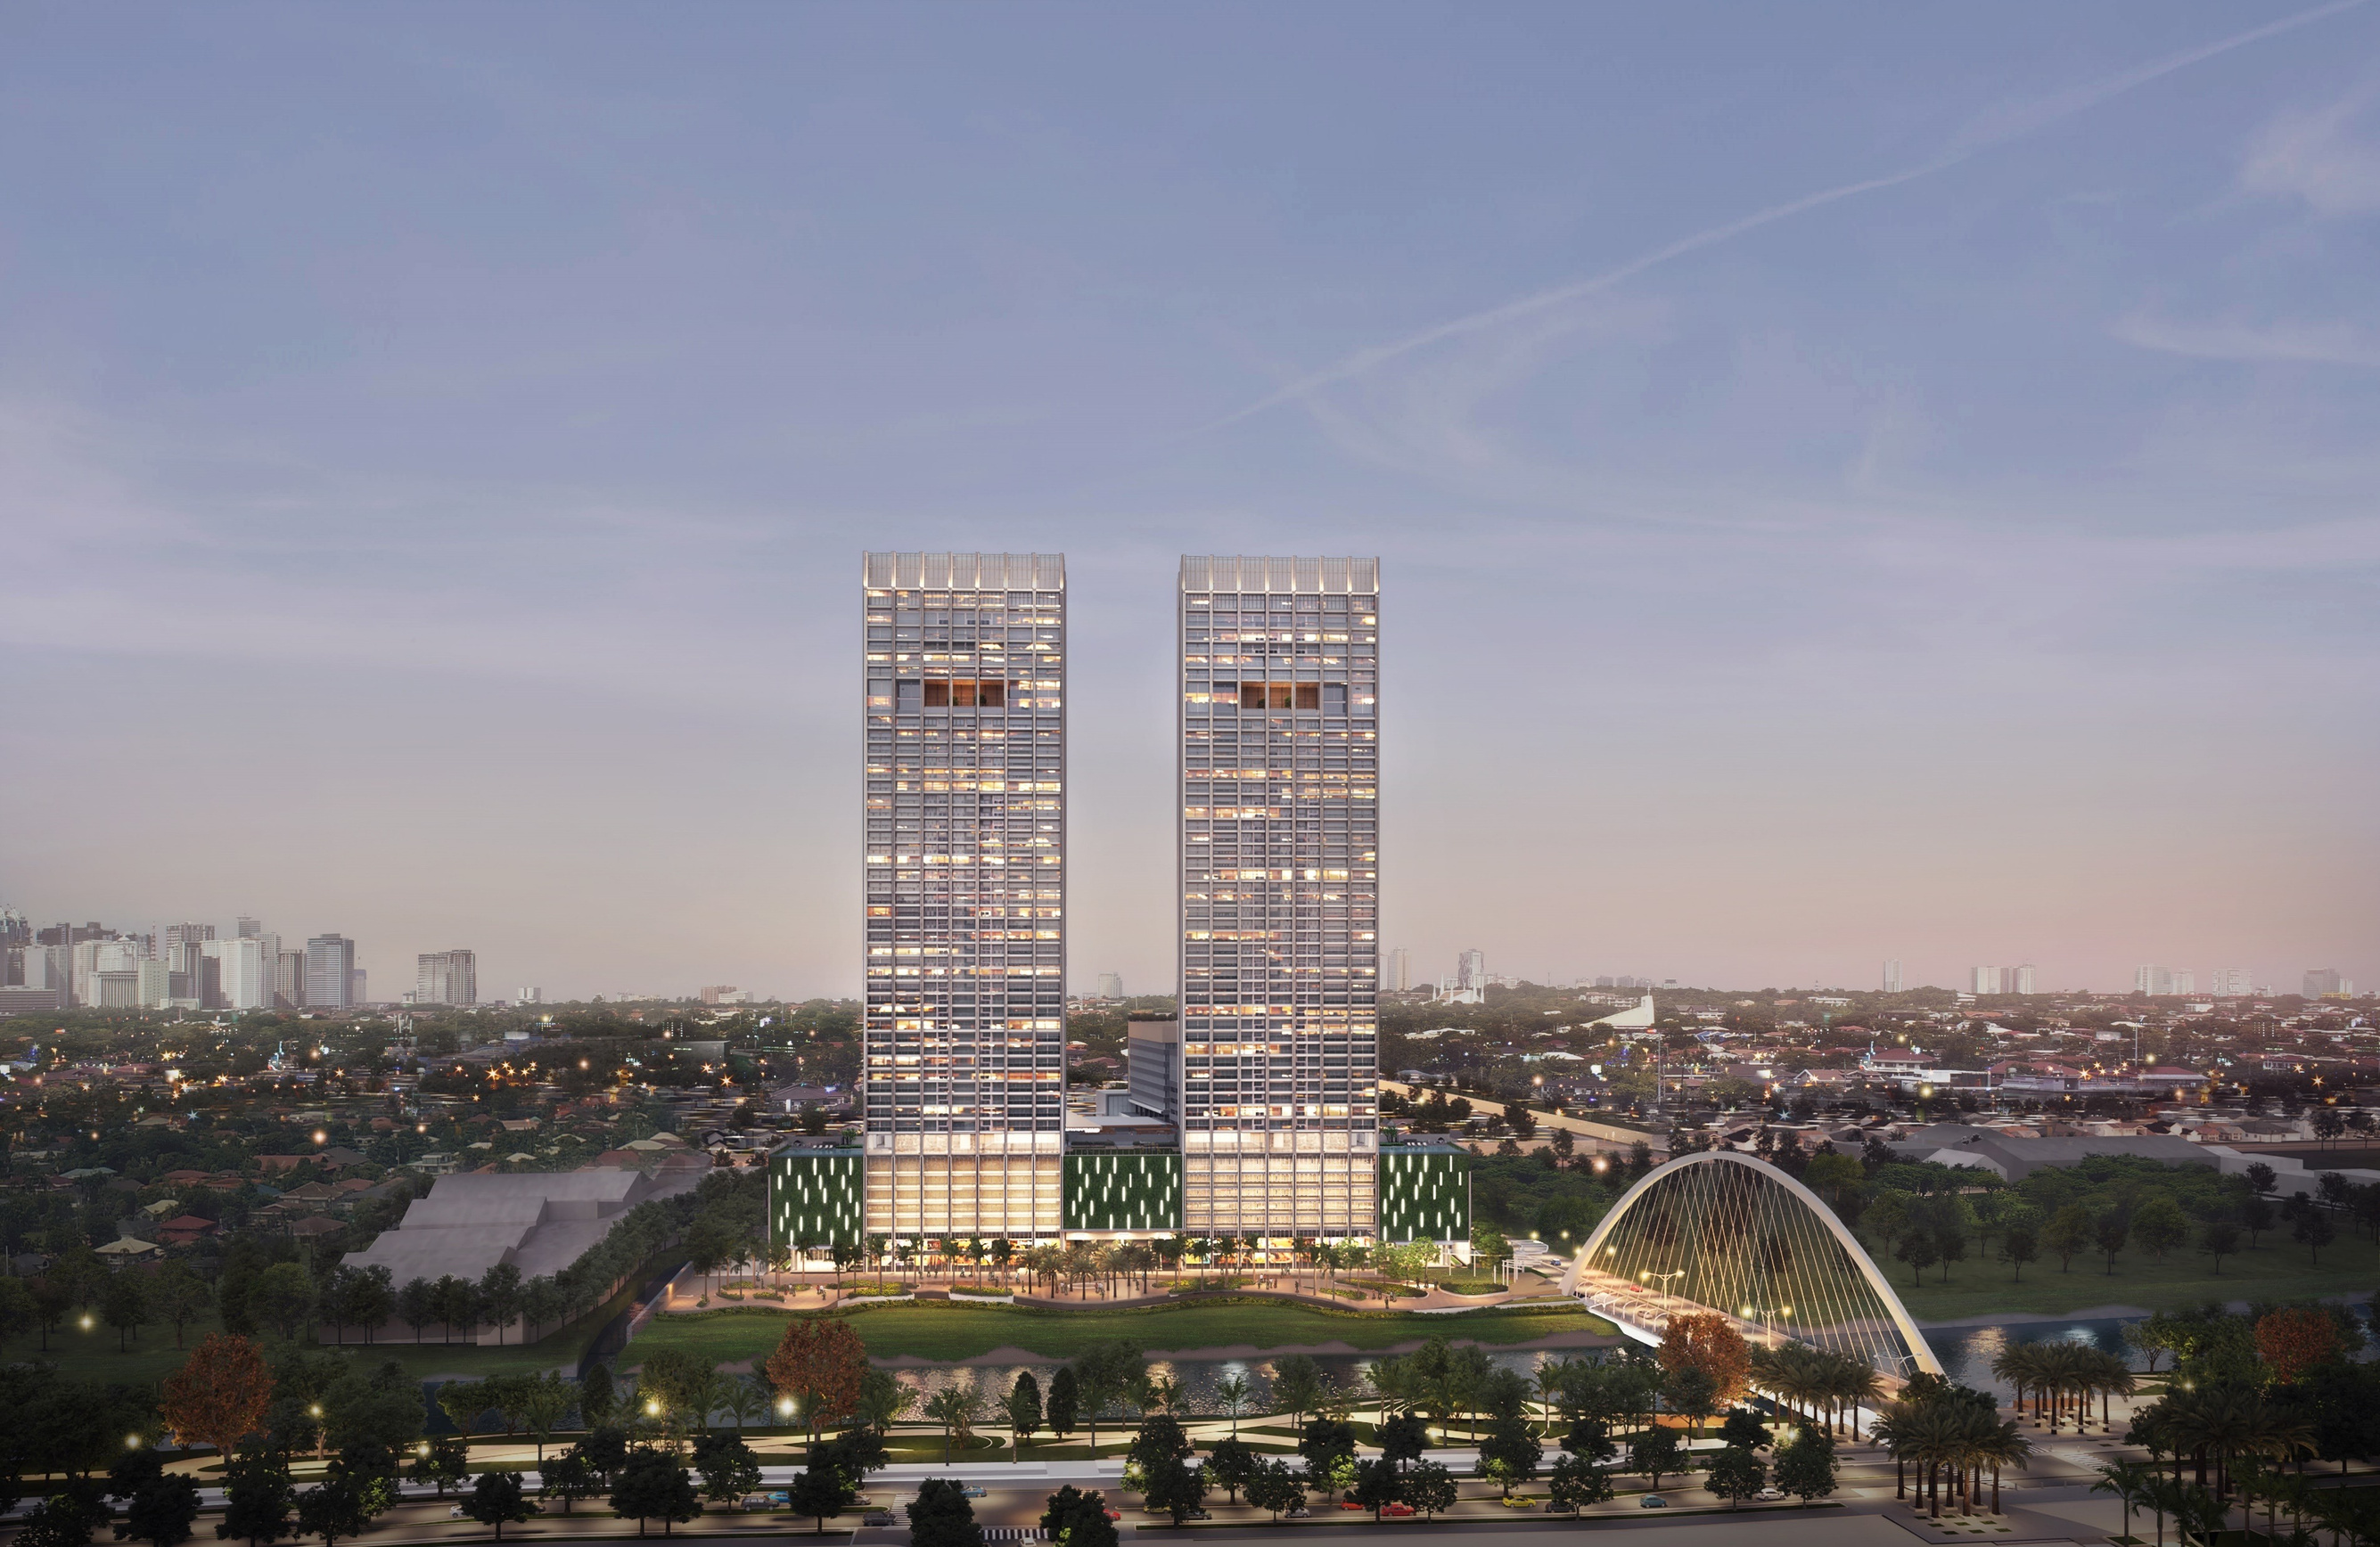


Slide 43
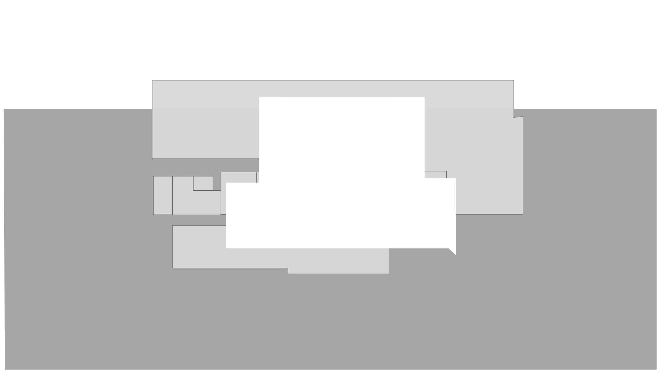
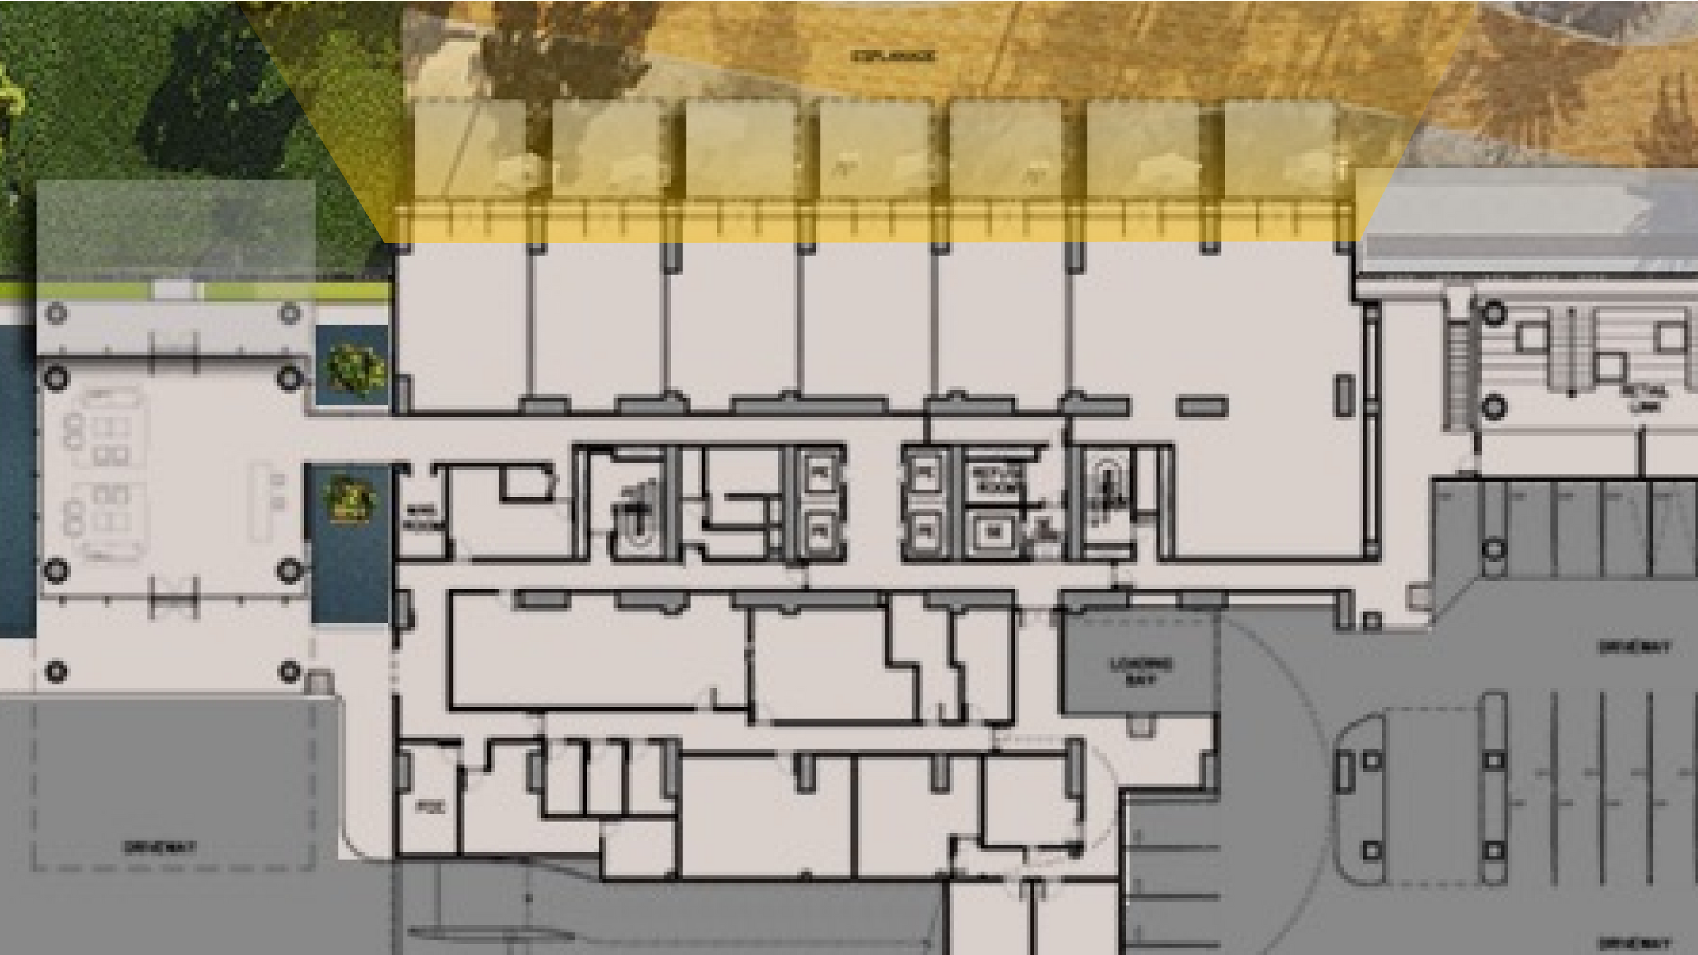
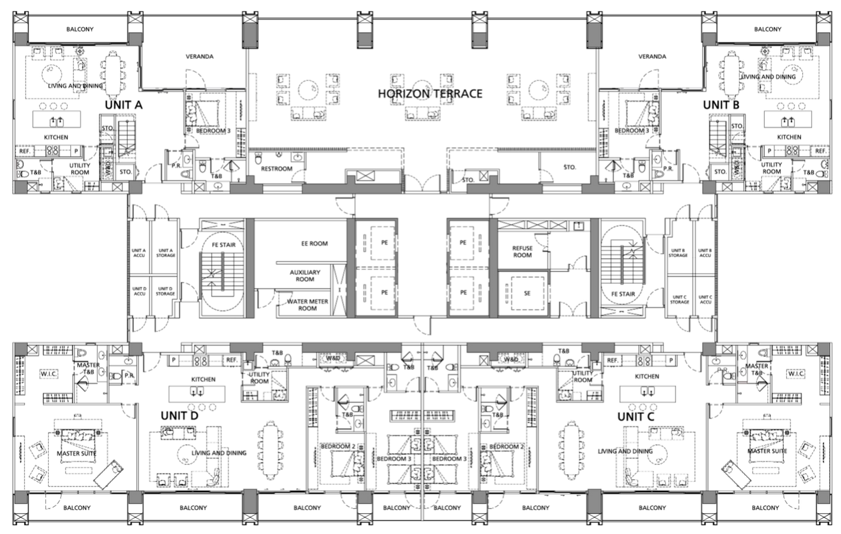
ESPLANADE | PARKLINKS | ANTIPOLO MOUNTAIN RANGE
RESIDENTIAL UNIT
RESIDENTIAL UNIT
RESIDENTIAL LOADING BAY
RESIDENTIAL UNIT
RESIDENTIAL UNIT
AYALA MALLS PARKLINKS | GREENMEADOWS | ORTIGAS SKYLINE

Slide 44

HORIZON TERRACE

Slide 45


residential units

Slide 46
Residential Offerings
Residential Offerings
UNIT TYPE
UNIT TYPE
NO.OF UNITS
NO.OF UNITS
TOTAL AREA
TOTAL AREA
BALCONY AREA
BALCONY AREA
1BR Standard
1BR Standard
92
92
70-71 sqm
70-71 sqm
9 sqm
9 sqm
2BR Standard
2BR Standard
171
171
142-161 sqm
142-161 sqm
19 sqm
19 sqm
3BR Standard
3BR Standard
28
28
208-217 sqm
208-217 sqm
29 sqm
29 sqm
3BR Horizon Villa
3BR Horizon Villa
2
2
286 sqm
286 sqm
37 sqm
37 sqm
3BR Sky Villa
3BR Sky Villa
20
20
269 sqm
269 sqm
34 sqm
34 sqm
Note: Areas are approximate and are represented in square meters (sqm)
Note: Areas are approximate and are represented in square meters (sqm)

Slide 47

EAST-FACING UNITS
WEST-FACING UNITS
SKY FLOORS 47F TO 55F
3BR SKY VILLA
3BR SKY SUITE
2BR SKY SUITE
HORIZON FLOORS 35F TO 46F
HORIZON TERRACE
3BR HORIZON VILLA
3BR HORIZON SUITE
2BR HORIZON SUITE
CLASSIC FLOORS 11F TO 34F
2BR CORNER RESIDENCE
2BR CLASSIC RESIDENCE
1BR CLASSIC RESIDENCE
10F GF TO 9F
AMENITY DECK
AMENITY DECK
RETAIL PODIUM AND PARKING
RETAIL PODIUM AND PARKING

Slide 48


EAST VIEWS Parklinks Estate
Marikina River
Antipolo Mountain Range
Height in meters of
Distance between
PNST
PNT and PST
Distance between
PNST and Lattice
Height and number of floors of Lattice
Distance between PNST
and the nearest
building line across the river
Distance between lowest
resi balcony
with nearest point of the mall
Highest possible point of the mall (worst case)
Highest possible height of this parcel (based on FAR)
Height of Parklinks Bridge
Width of Es pl anade

Slide 49

EAST VIEW FROM THE 55TH FLOOR

Slide 50

WEST VIEWS Green Meadows
San Juan
Ortigas Skyline

Slide 51

WEST VIEW FROM THE 55TH FLOOR

Slide 52

Low-Emissivity Glass
Solar energy is reflected back outside.
Solar energy is reflected back outside.
Low-emissivity or low-e glass is used to minimize the amount of heat that travels through the glass without sacrificing the amount of light that enters.
Solar energy is reflected back outside.
Low-emissivity or low-e glass is used to minimize the amount of heat that travels through the glass without sacrificing the amount of light that enters.
Low-emissivity or low-e glass is used to minimize the amount of heat that travels through the glass without sacrificing the amount of light that enters.
The cool
The cool
The cool
temperature stays inside
your home.
temperature stays inside
your home.
temperature stays inside
your home.
keeps your home cool all-year round
protects your furniture and furnishings from
heat damage
keeps your home cool all-year round
protects your furniture and furnishings from
heat damage
UV rays are
•
•
UV rays are
reflected back outside.
reflected back outside.

Slide 53
EAST-FACING UNITS
WEST-FACING UNITS
SKY FLOORS 47F TO 55F
3BR SKY VILLA
3BR SKY SUITE
2BR SKY SUITE
HORIZON FLOORS 35F TO 46F
HORIZON TERRACE
3BR HORIZON VILLA
3BR HORIZON SUITE
2BR HORIZON SUITE
CLASSIC FLOORS 11F TO 34F
2BR CORNER RESIDENCE
2BR CLASSIC RESIDENCE
1BR CLASSIC RESIDENCE
10F GF TO 9F
AMENITY DECK
AMENITY DECK
RETAIL PODIUM AND PARKING
RETAIL PODIUM AND PARKING

Slide 54


Slide 55

Spacious balcony

Slide 56

Maximized Natural Light
Maximized Natural Light
Maximized Natural Light
STANDARD UNIT WINDOW HEIGHT: 2.4 METERS
STANDARD UNIT WINDOW HEIGHT: 2.4 METERS
STANDARD UNIT WINDOW HEIGHT: 2.4 METERS
SKY UNIT WINDOW HEIGHT: 2.7 METERS
SKY UNIT WINDOW HEIGHT: 2.7 METERS
SKY UNIT WINDOW HEIGHT: 2.7 METERS

Slide 57
EAST-FACING UNITS
WEST-FACING UNITS
SKY FLOORS 47F TO 55F
3BR SKY VILLA
3BR SKY SUITE
2BR SKY SUITE
HORIZON FLOORS 35F TO 46F
HORIZON TERRACE
3BR HORIZON VILLA
3BR HORIZON SUITE
2BR HORIZON SUITE
CLASSIC FLOORS 11F TO 34F
2BR CORNER RESIDENCE
2BR CLASSIC RESIDENCE
1BR CLASSIC RESIDENCE
10F GF TO 9F
AMENITY DECK
AMENITY DECK
RETAIL PODIUM AND PARKING
RETAIL PODIUM AND PARKING

Slide 58



VIEWS: RIVER ESPLANADE | PARKLINKS | ANTIPOLO MOUNTAIN RANGE
2BR CORNER
2BR CLASSIC
1BR CLASSIC
2BR CORNER
2BR
STORAGE
2BR
STORAGE
& ACCU
& ACCU
2BR
STORAGE
2BR
STORAGE
& ACCU
& ACCU
E
S
N
2BR CORNER
1BR CLASSIC
1BR CLASSIC
1BR CLASSIC
2BR CORNER
W
VIEWS: PARKLINKS MALL | GREENMEADOWS | ORTIGAS SKYLINE

Slide 59


VIEWS: RIVER ESPLANADE | PARKLINKS | ANTIPOLO MOUNTAIN RANGE
2BR HORIZON SUITE
3BR HORIZON SUITE
2BR HORIZON SUITE
2BR
STORAGE
2BR
STORAGE
& ACCU
& ACCU
2BR
STORAGE
2BR
STORAGE
& ACCU
& ACCU
E
S
N
2BR HORIZON SUITE
3BR HORIZON SUITE
2BR HORIZON SUITE
W
VIEWS: PARKLINKS MALL | GREENMEADOWS | ORTIGAS SKYLINE

Slide 60


VIEWS: RIVER ESPLANADE | PARKLINKS | ANTIPOLO MOUNTAIN RANGE
3BR HORIZON VILLA
3BR HORIZON VILLA
3BR
STORAGE
3BR
STORAGE
& ACCU
& ACCU
2BR
STORAGE
2BR
STORAGE
& ACCU
& ACCU
E
S
N
2BR HORIZON SUITE
3BR HORIZON SUITE
2BR HORIZON SUITE
W
VIEWS: PARKLINKS MALL | GREENMEADOWS | ORTIGAS SKYLINE

Slide 61


VIEWS: RIVER ESPLANADE | PARKLINKS | ANTIPOLO MOUNTAIN RANGE
3BR SKY VILLA
3BR SKY VILLA
3BR
STORAGE
3BR
STORAGE
& ACCU
& ACCU
2BR
STORAGE
2BR
STORAGE
& ACCU
& ACCU
E
S
N
2BR SKY SUITE
3BR SKY SUITE
2BR SKY SUITE
W
VIEWS: PARKLINKS MALL | GREENMEADOWS | ORTIGAS SKYLINE

Slide 62

Featured Unit Layout
Parklinks North Tower 3br West Sky Suite Parklinks South Tower 3br Sky Villa

Slide 63

standard unit finishes and fixtures
ROOM AREA
FLOOR
WALL
CEILING
APPLIANCES
Foyer
Living/Dining Area
Porcelain Tile
Porcelain Tile
Painted
Painted
Painted Gypsum
Painted Gypsum
Painted, Moisture-
resistant Gypsum
Painted
Painted Gypsum
Painted, Moisture-
resistant Gypsum
Painted Gypsum
Air-conditioning Unit
Powder Room*
Balcony
Master Bedroom
Porcelain Tile
Porcelain Tile
Engineered Wood
Painted
Painted
Painted
Air-conditioning Unit
Master T&B
Secondary
Bedrooms
Porcelain Tile
Porcelain Tile
Water Heater
Engineered Wood
Painted
Air-conditioning Unit
Secondary/
Common T&B
Porcelain Tile In
Shower Area /
Painted In Other Areas
Porcelain Tile
Painted, Moisture- resistant Gypsum
Water Heater
Range Hood, Free-standing Range, Water Heater
Kitchen
Porcelain Tile
Painted
Painted Gypsum
Utility Room*
Porcelain Tile
Painted
Painted Gypsum
Porcelain Tile In
Shower Area /
Painted In Other Areas
Utility T&B*
Porcelain Tile
Painted, Moisture- resistant Gypsum

Slide 64





Brand Partners
BRAND
AREA
COMPONENT
BRAND WEBSITE
Kitchen
Kitchen Cabinets
www.siematic.com
Bathroom
Bathroom Fittings
www.hansgrohe.com
Bathroom
Lavatory and Water Closet
www.duravit.com
Kitchen
Range Hood and Free-standing
www.smeg.com
Range

Slide 65

Living Dining Area

Slide 66


Slide 67


Slide 68

Powder Room

Slide 69


Slide 70

Secondary Bedroom

Slide 71


Slide 72

Secondary/Common
T&B

Slide 73


Slide 74

Media
Room

Slide 75


Slide 76

Flexible Living Spaces

Slide 77

Secondary/Common
T&B

Slide 78

Master Bedroom

Slide 79

Master T&B

Slide 80


Slide 81


Slide 82
Featured Unit Layout
Parklinks North Tower 3br West Sky Suite
Parklinks South Tower
3br Sky Villa
Featured Unit Layout
Parklinks North Tower 3br West Sky Suite
Parklinks South Tower
3br Sky Villa

Slide 83

Turnover
Q2 2029

Slide 85




Competitor Residential Offerings
• • • •
•
1BR Standard – 70- 71 sqm 2BR Standard – 142 - 161 sqm 3BR Standard – 208-217 sqm 3BR Horizon Villa – 286 sqm
3BR Sky Villa – 269 sqm
• • • •
•
1BR Executive – 46 sqm 1BR Deluxe – 51.5 sqm 1BR Premium – 59.5 sqm 2BR Suite – 105.5 sqm
3BR Suite – 158 sqm
• • • •
Studio – 30 - 33 sqm 1BR – 58 - 61 sqm 2BR – 92 - 95 sqm 3BR – 124 sqm
• • •
1BR Typical – 81 - 85 sqm 2BR Typical – 142 - 173 sqm 3BR Typical – 231 – 281 sqm
• •
Density – 6 - 10 units per floor Total Units: 404
• •
Density – 5 - 15 units per floor Total Units: 530
• •
Density – 4 - 9 units per floor Total Units: 313
• •
Density – 4 - 14 units per floor Total Units: 502

